Slide 1
Clinical Health Solutions Spotlight
2024

Slide 2
Health Care
Managment

Slide 3

Health Care Management
Utilization Management
Case Management
URAC accredited
MCG standards
Customizable pre-cert lists
Focused on medical necessity for safe and cost-effective care
Acute case management
Member focused approach to help members navigate through their care by supporting their goals as well as their providers treatment plan
The Right Team
Integration
Physician on staff
Registered nurses for utilization review and case management
UR nurses all MCG certified
Case managers all CCM certified
Claims, for limited member disruption
Plan design, for customized approach for clients
Implementation, for holistic start to finish support
Eligibility, for complete member access
3
CONFIDENTIAL AND PROPRIETARY – FOR INTERNAL USE ONLY
3

Slide 4

Luminare Health
Clinical Health Solutions
Enhancements*
Impact of Enhancements
Specialty Case Management to include cancer care coordination, dialysis/end- stage renal disease (ESRD), behavioral health and high- risk maternity care.
Chronic Condition Management to include hypertension, diabetes, obesity, chronic obstructive pulmonary disease (COPD)/asthma, and coronary artery disease (CAD).
Earlier identification of members qualifying for programs will allow earlier referrals into these programs.
Member education and empowerment for medication compliance and overall improvement of health outcomes.
*Specialty Case Management & Chronic Condition Management are available as a buy-up option
4
CONFIDENTIAL AND PROPRIETARY – FOR INTERNAL USE ONLY

Slide 5
Clinical Health
Solutions

Slide 6






Clinical Health Management Program
Low cost, high-value solutions that address each population’s unique healthcare needs
Determinants of Health¹
Demographics
Health Risk Assessments
Biometrics
Utilization Management Data
Pharmacy Data
Claims Data
Predictive Data Engine
  Acute: The member has or develops a serious medical concern and/or is in immediate need of care and support.
  Chronic: The member has recorded diagnosis of a chronic health condition and may utilize condition-specific support
  At Risk: Data indicates that without intervention the member is at risk of worsening health and/or developing a chronic condition.
  Well: The member is generally healthy and can utilize solutions that focus on wellness and maintaining their health.
ACUTE
7% of population 29% of health care costs²
CHRONIC
27% of population 47% of health care costs²
AT RISK
20% of population 11% of health care costs²
WELL
46% of population 13% of health care costs²
Specialty Case Management Programs
Complex Case Management (complex and catastrophic cases)
Chronic Condition and At-risk Management Programs
When program goals are met, members transition to lower -intensity programs
Population Health Management and Health Coaching
on
Benefit Support and Advocacy, Care Navigation
Mental Health and Substance Use Care Coordination
Utilization Management Program (medical necessity, appropriateness, efficiency of health care services, procedures and in-facility care)
Nurse-driven
Member-driven
¹Not all data points may be available for all clients.
²Oliver Wyman, 2014. Adjusted to compress health status categories. Acute episodic care costs excluded from analysis.
6
CONFIDENTIAL AND PROPRIETARY – FOR INTERNAL USE ONLY

Slide 7





Luminare Health-Clinical Health Solutions
Low cost, high-value solutions that address each population’s unique healthcare needs
Clinical Health Solutions
Health Management and Wellness
Behavioral Health
Solutions
Women’s and Family
Health
Musculoskeletal (MSK) Care
Teladoc Health Chronic Condition Management Plus (CCM+)
7
CONFIDENTIAL AND PROPRIETARY – FOR INTERNAL USE ONLY
Notes:
Enhanced HCM model on Luminare Health – new HCM offering established on the model to offer a WBM-like solution
New offering 10/01/2024
OnLife
Ovia
Hinge
Headway

Slide 8





Health Management and Wellness powered by Onlife Health
With the Well onTarget Portal members can:
Close Gaps in Care
Take a Health Assessment
Set personal health and wellness goals
Engage in Self-Management programs
Access online educational resources
Connect with a wellness coach
And much more
Advocate for Members
Deliver Savings
Take wellness on the go with the AlwaysOn mobile app
8
CONFIDENTIAL AND PROPRIETARY – FOR INTERNAL USE ONLY

Slide 9

Health Management Topics
Obesity
Pre-Diabetes
Physical Activity
Sleep
Stress
Tobacco
Weight Management/
Maintenance
Bones and Joints
Cholesterol
Congestive Heart Failure
COPD/Asthma
Coronary Artery Disease
Diabetes
Hypertension
Nutrition
CONFIDENTIAL AND PROPRIETARY – FOR INTERNAL USE ONLY
9
Notes:
Revised 4/24
EMI Team: Deborah Wells, Debb Bastian
Communications Consultant: Greg Alford
Reviewed by: Stephanie Barrera, Vivian Jones, Mary Ellen Anderson, Ali Dowe, Lacrisha Hicks

Slide 10




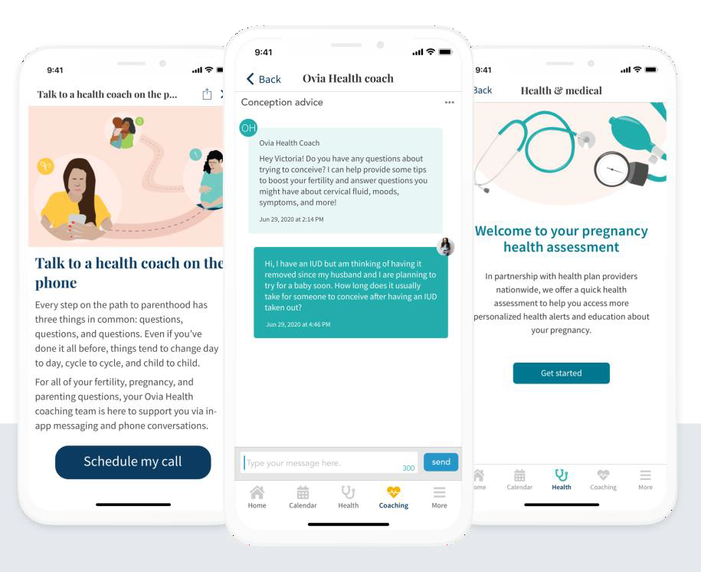
Women’s and Family Health Powered by
Ovia Health
A complete suite of services for every family, at every stage, in every community.
Navigation and support from fertility to pregnancy to parenting
In-app and telephonic coaching
Ongoing education resources
Data-driven messaging
Aims to improve clinical outcomes, reduce costs and help parents successfully return to work
CONFIDENTIAL AND PROPRIETARY – FOR INTERNAL USE ONLY
10

Slide 11

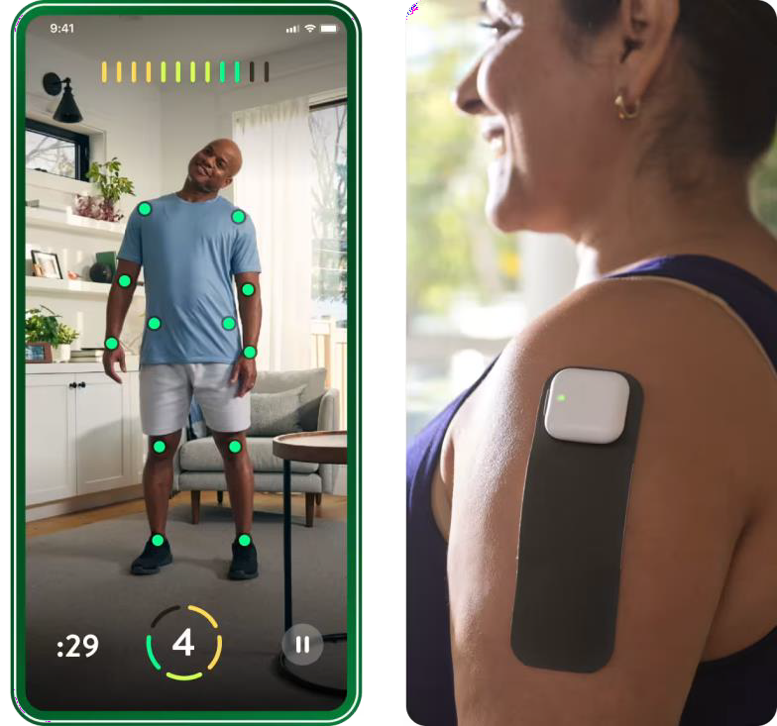
Musculoskeletal (MSK) Care Powered by
Hinge Health
Digital Tools for Joint and Muscle Pain Management
Led by a clinical Care Team equipped to meet a range of unique needs
Advanced Technology that provides instant feedback and helps improve form
Wearable devices that help address MSK pain without drugs or surgery
68%
Average reduction in pain per participant¹
1Bailey et al. (2020) 12-week digital care for chronic back and knee MSK pain. JMIR. (N=10,264)
11
CONFIDENTIAL AND PROPRIETARY – FOR INTERNAL USE ONLY

Slide 12

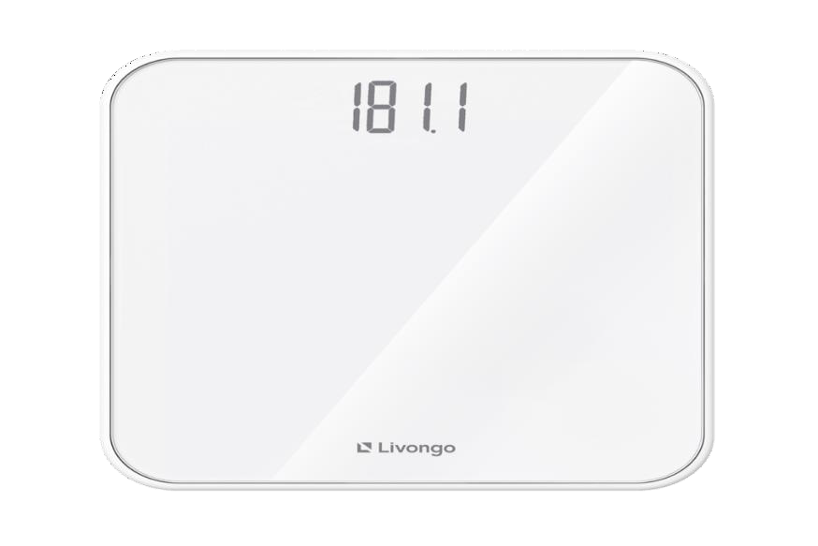
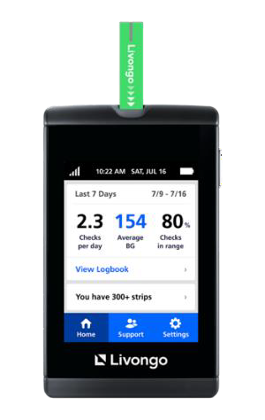
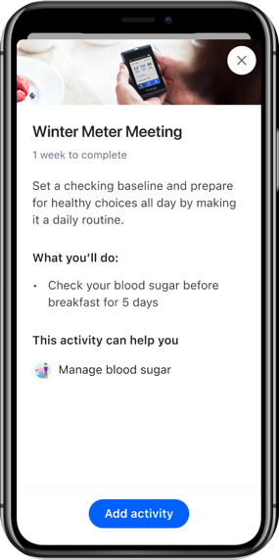
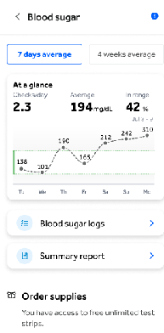
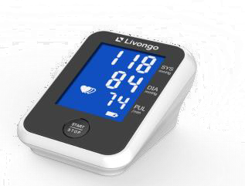
Chronic Condition Management Plus (CCM+) Powered by Teladoc Health
Packaged care and support for chronic conditions with smart devices, expert coaches and personalized plans.
Multi-Condition Support for
People with Diabetes
People with Hypertension
People with Prediabetes
Hypertension Weight Mental Health | Weight Mental Health | Hypertension Weight Mental Health
Effortless Data Collection Commonly used mobile device apps based on condition | Personalized Health Signals Lifestyle change, medication adherence, emotional support | Human-centered Approach Digital and expert coaching adapts to member needs
CONFIDENTIAL AND PROPRIETARY – FOR INTERNAL USE ONLY
12

Slide 13

Behavioral Health Support Powered by
Headway
Increased Access and Options at Members’ Fingertips
Personalized Matching
Availability within
48 hours
In-person or Virtual Care
Specialist Network of 26,000+ therapists, psychiatrists, and psychologists
Easy-to-use Platform
Affordable and Transparent Pricing
Notes:
Behavioral Health provider finder for in-network providers with search criteria based on member preference and member matching criteria along with an appointment scheduler

Slide 14

Behavioral Health Solutions
Anxiety
Chronic Condition Comorbidity
Depression
Employee Assistance Program
Individual In-Person Counseling
Individual Virtual Counseling (Telehealth)
Inpatient
Outpatient
Substance-Use Care
14
CONFIDENTIAL AND PROPRIETARY – FOR INTERNAL USE ONLY
CONFIDENTIAL AND PROPRIETARY – FOR INTERNAL USE ONLY
Notes:
Revised 4/24
EMI Team: Deborah Wells, Debb Bastian
Communications Consultant: Greg Alford
Reviewed by: Stephanie Barrera, Vivian Jones, Mary Ellen Anderson, Ali Dowe, Lacrisha Hicks

Slide 15
Clinical Health Solutions
Offered

Slide 16
Clinical Health Solutions
CHS
Base Package
CHS Buy-up Options
Case Management
Base Case Management (Acute & Catastrophic) | LH-HCM | ●
Specialty Utilization Management
Base Utilization Management (Comprehensive Inpatient UM, Partial Hospitalization, HHC) | LH-HCM | ●
Option 1-Limited Outpatient Surgeries, Outpatient Joint Replacements, Cosmetic Procedures, Varicose Veins, Cochlear Implants (Any customization will need pricing review) | LH-HCM
Option 2-DME over $2,500, Radiation/Chemotherapy, Dialysis, Genetic Testing, Interventional Radiology, MRI/PETs (Not done in ER), PT/OT/Speech a/12 visits, Limited High-Cost Drug Review (Any customization will need pricing review) | LH-HCM
Option 3-Specialty Drug Preauthorization Expansion (Includes vended Prior Authorization for Medical Oncology Drug) (Any customization will need pricing review) | LH-HCM
Option 4- Buy Up - (Client specific prior authorization list) (will need prior auth list review for pricing estimate) | LH-HCM
Clinical Chronic Conditions Management (CCM)/Disease Management (DM)
Nurse led CCM/DM Program (6 conditions - Obesity, COPD/Asthma, Diabetes, CAD, Hypertension) | LH-HCM
16
CONFIDENTIAL AND PROPRIETARY – FOR INTERNAL USE ONLY
Notes:
Whats Offered with Base Case Management

Slide 17
Clinical Health Solutions
Standard Case Management
Health Management
Point
Solution
Vendor
CHS
Package
Buy-up Options
Standard and Specialty Utilization Management
Health assessment & wellness reporting | Pager Health (Onlife) | ●
Activity tracking and monitoring | Pager Health (Onlife) | ●
Web and mobile app with access to digital self-management programs (more than 23 different topics) and health and wellness information. | Pager Health (Onlife) | ●
Device integrations (fitness, nutrition, scales & blood pressure cuffs) and tracking | Pager Health (Onlife) | ●
Personal challenges | Pager Health (Onlife) | ●
Progress check-in | Pager Health (Onlife) | ●
Searchable content & symptom checkers | Pager Health (Onlife) | ●
Virtual and live 1 on 1 coaching for wellbeing and condition management topics: Decrease weight, Maintain weight, Manage stress, Quit tobacco, Improve blood pressure, Improve cholesterol, Improve dietary habits, Improve fitness level, Maintain tobacco-free status. | Pager Health (Onlife) | ●
Standard (points-based) incentive tracking and reporting, including gamification | Pager Health (Onlife) | ●
Fitness/Gym Membership Discount Program | Active & Fit Direct | ●
Clinical Chronic Conditions Management (CCM)/Disease Management (DM)
Health Management
Health Management Cont.
Behavioral Health
17
Notes:
Whats Offered

Slide 18
Clinical Health Solutions
Standard Case Management
Health Management
Point
Solution
Vendor
CHS
Package
Buy-up Options
Standard and Specialty Utilization Management
Fertility and Reproductive Health | Ovia | ●
Maternity & Postpartum | Ovia | ●
Parenting (including Surrogacy & Adoption support) | Ovia | ●
Perimenopause & Menopause | Ovia | ●
myNurseline with 24/7 nurse line support | Carenet | ●
Digital BH tools and programs | Pager Health (Onlife) Teladoc CCM+ | ●
Targeted diabetes prevention, diabetes management, hypertension management programs, weight management, behavioral health resources. Includes: digital tools and resources, coaching, personalized experience | Teladoc CCM+ | ●
Virtual MSK and physical therapy programs | Hinge Health | ●
Behavioral Health provider finder for in-network providers with search criteria based on member preference and member matching criteria along with an appointment scheduler | Headway | ●
Clinical Chronic Conditions Management (CCM)/Disease Management (DM)
Health Management
Health Management
Behavioral Health
18
Notes:
Whats Offered

Slide 19
Clinical Health Solutions
Standard Case Management
Behavioral Health
CHS
Package
Buy-up Options
Point
Solution
Vendor
Standard and Specialty Utilization Management
Telemedicine for: General Medical and Behavioral Health (Addiction, Domestic abuse or relationship conflicts Grief counseling, Stress, anxiety or depression) | Teladoc
Clinical Chronic Conditions Management (CCM)/Disease Management (DM)
Health Management
Health Management cont.
Behavioral Health
19

Slide 20
Key vendor differences between BCBSxx Full-Service and Luminare Health’s-Clinical Health Solutions
Program | Key Differences
Well onTarget Portal | Information about this program will live on the myBlueElement portal/app Members will access via SSO from myBlueElement to Well onTarget Biometric Screenings and Fitness Program enrollment/activity will not be eligible for Blue Points WBM or WoT email campaign will not be available to LH’s CHS members
Ovia Health | Information about this program will live on the myBlueElement portal/app QR codes to download the app will be used on myBlueElement for members to download the apps Luminare Health’s OB clinicians will outreach/support high-risk pregnant members
Hinge Health | Cannot opt-out of this from CHS bundle Information about this program will live on the myBlueElement portal/app QR codes to download the app will be used on myBlueElement for members to download the apps
Note: One marketing email highlighting the CHS program, including these vendors, is being planned for Q1 2025; additional conversations under way on developing a full email campaign underway
Notes:
Luminare Health’s Clinical Health Solution will leverage 3 HCSC vendor relationships: Well onTarget Portal (Onlife/Pager Health), Ovia Health, Hinge Health
Some capabilities will differ based on foundational differences between the models
Program Reporting - For MVP, it will be LH standard reporting and supplemented by vender reporting where appropriate. Reporting will continually be enhanced and integrated as solution matures.

Slide 21
Key Takeaways
Clinical Health Solutions was designed to align to current HCSC HCM offerings, but has noted nuances/differences
Clinical Health Solutions is available for LH-ADM and LH-ADM Tribal clients. This will not be offered to COUPE clients at this time
Clinical Health Solutions is a bundled offering at this point. Clients cannot OPT out of different PSV offered in the bundle at this time. This will be an option in the future
This solution will continue to expand capabilities as it matures, your feedback and insights are welcomed
Provides value through access, affordability and empowerment
21

Slide 22


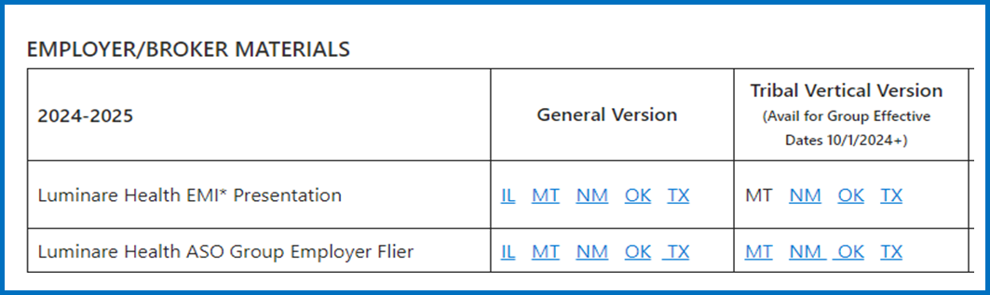
ADM Luminare Health Resources
ADM Hub Luminare Health
BrandSource (Luminare Health)
Clinical Health Solutions Fliers
ADM Hub LH

Slide 23
Questions?

Slide 24
Appendix

Slide 25
Health Management: Chronic Management and Specialty Case Management
Dedicated Registered Nurse Case Manager support to improve overall health and wellbeing.
Condition Specific Assessments and Care Plans based on evidence-based practices guide members based on health goals.
Member support and advocacy to navigate the complexities of the health care system.
Member education and support to build knowledge of disease process and ongoing self- management including medication management, symptom monitoring, and lifestyle management.
Preventive Care education and assistance to close gaps in care.
Assessment of Social Determinants of Health needs and assistance with connecting to local and community resources to support member’s needs.
Integration with local health resources.
CONFIDENTIAL AND PROPRIETARY – FOR INTERNAL USE ONLY
25

Slide 26

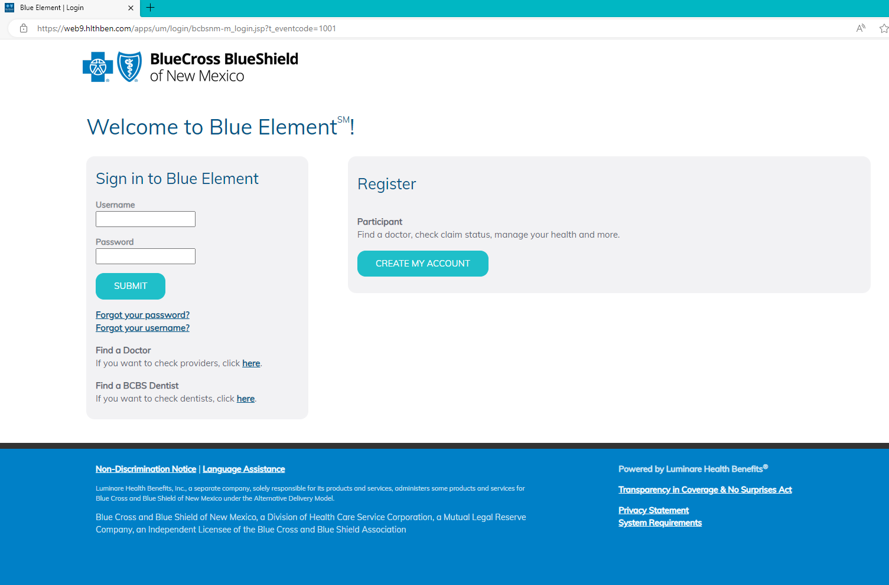

myBlueElementSM – Member Portal
Quickly view, filter and sort claims for easy reference
Check account balances
Create separate logins for family members
Contact customer service
Quickly view each family member’s coverage
View tailored employer messages
View secure electronic explanation of benefits
CONFIDENTIAL AND PROPRIETARY – FOR INTERNAL USE ONLY
26
Notes:
Revised 4/24
EMI Team: Deborah Wells, Debb Bastian
Communications Consultant: Greg Alford
Reviewed by: Stephanie Barrera, Vivian Jones, Mary Ellen Anderson, Ali Dowe, Lacrisha Hicks

Slide 27
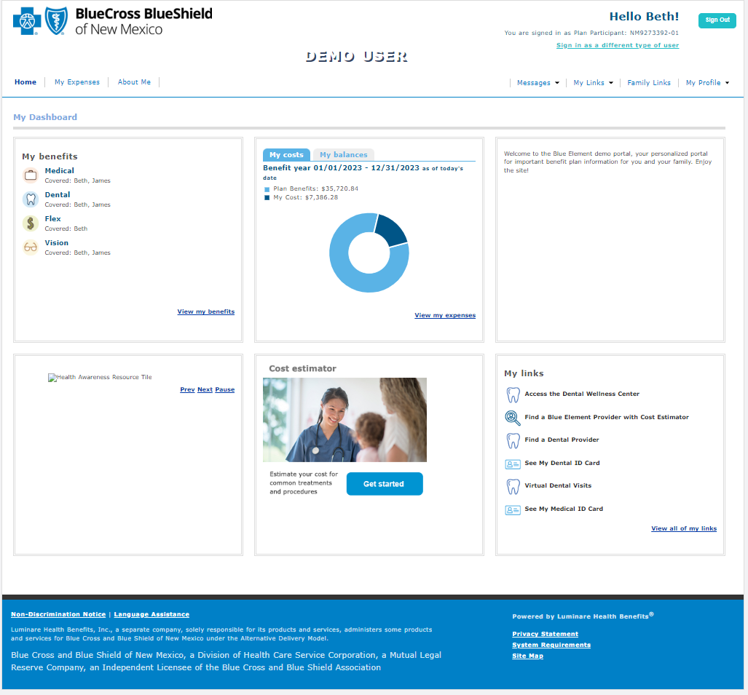
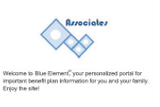
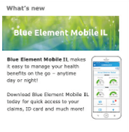
myBlueElementSM – Online Portal
Easy navigation and customized content makes our member portal
user-friendly
Customized Dashboard Content
Your logo and custom messaging
Links to find a doctor, see an ID card, access
product offerings – any link or document important to your members, customized to the member’s specific eligibility
Customized, scrollable images to promote products, health awareness resources and informational content
Information Important to Members
Access to claim details and to view EOBs
Access to benefit details and SPDs
Secure message center to communicate with Customer Service
Luminare Health Benefits, Inc., a separate company, solely responsible for its products and services, administers some products
and services for Blue Cross and Blue Shield of Texas under the Alternative Delivery Model.
Blue Cross and Blue Shield of Texas, a Division of Health Care Service Corporation, a Mutual Legal Reserve Company, an Independent Licensee of the Blue Cross and Blue Shield Association
CONFIDENTIAL AND PROPRIETARY – FOR INTERNAL USE ONLY
27
Notes:
Revised 4/24
EMI Team: Deborah Wells, Debb Bastian
Communications Consultant: Greg Alford
Reviewed by: Stephanie Barrera, Vivian Jones, Mary Ellen Anderson, Ali Dowe, Lacrisha Hicks
Luminare Health can support inbound and outbound SSO to the Included Health portal. Services fees below.
Outbound SSO = $6,000
Inbound SSO = $10,500
Question for UPDATE Client Reporting
- Can Clients use Portal to see MLR reporting and savings

Slide 28
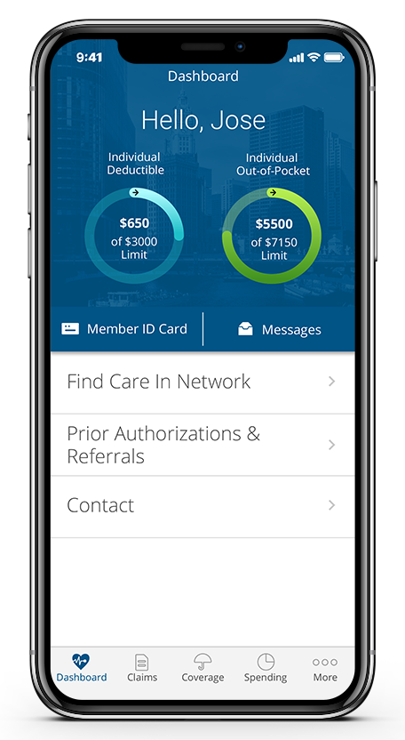

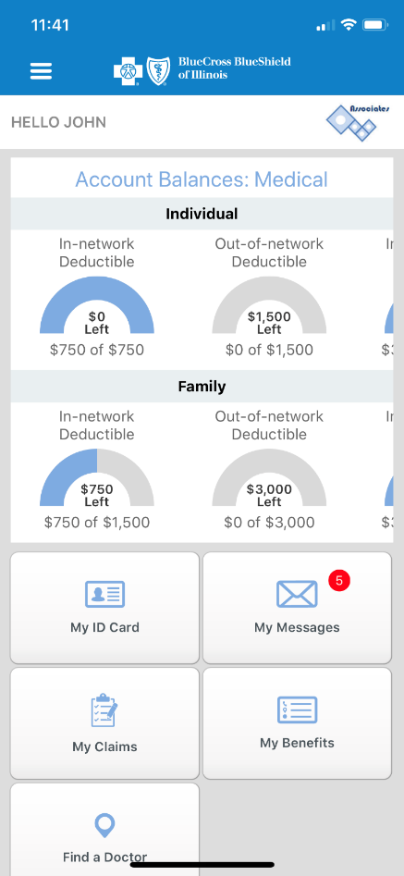

myBlueElementSM – Mobile App
By downloading the myBlueElement app,
members can:
HELLO BETH
See the status of deductible and out-of-pocket maximum
Show ID card to provider
View and filter claims for quick reference
Find a doctor
Easily access member-specific services in their health benefit plan
View family info and
health benefits
Access important benefits information
Filter claims by dependent and type
Contact Customer Service through the mobile message center
Contact Customer
Service by phone
Blue Cross and Blue Shield of Texas, a Division of Health Care Service
Download the app for free from
Apple or Google Play. Search for
Blue Element Mobile.
28
CONFIDENTIAL AND PROPRIETARY – FOR INTERNAL USE ONLY
Notes:
Revised 4/24
EMI Team: Deborah Wells, Debb Bastian
Communications Consultant: Greg Alford
Reviewed by: Stephanie Barrera, Vivian Jones, Mary Ellen Anderson, Ali Dowe, Lacrisha Hicks

