Slide 1
Welcome Journey
Promise Health Plan 2024
Luminare Health

Slide 2
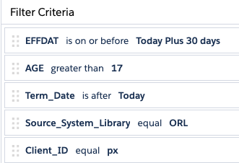
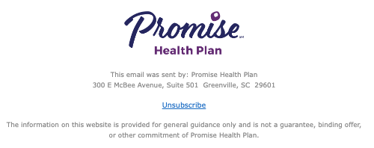
Promise Health Plan
Welcome Journey
Evaluates file each weekday for:
    Effective date is before today
        If effective date is in the future, hold until 1 day after effective date
    Age is greater than 17
    Termination date is after Today
    Footer:

Slide 3
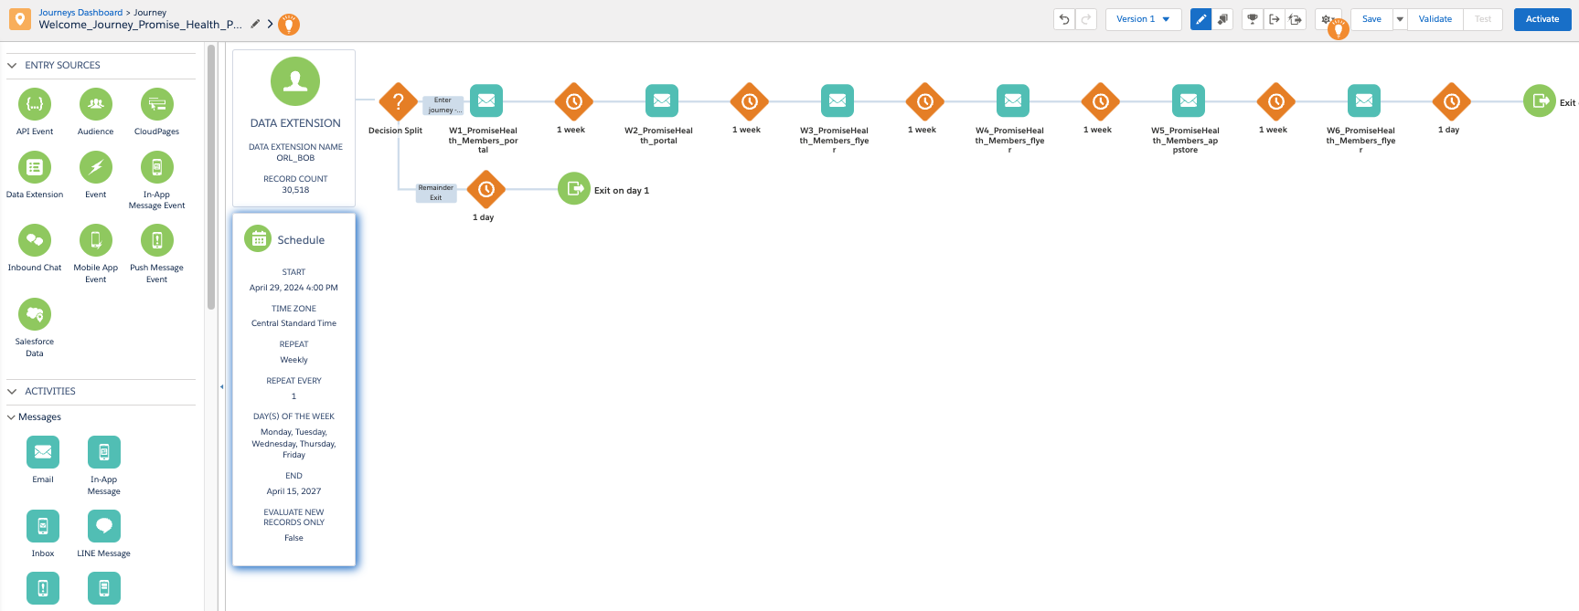
Promise Health Plan
Welcome Journey

Slide 4
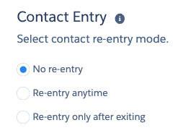
Run and entry criteria
Runs aprox 3 years
evaluates all records on first run, then only new
No re-entry allowed

Slide 5

Sender address/name
Monitored by Luminare Health for deliverability related issues

Slide 6
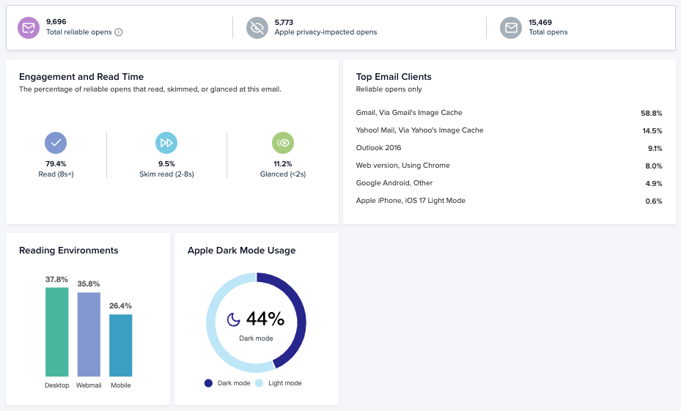
Litmus access
Data will update once activated
Access engagement dashboard
https://litmus.com/pub/a/hncbepbxh6XuIUGd

Slide 7
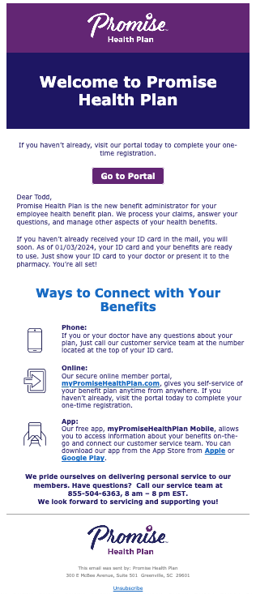
Email 1
Welcome
CTA = Portal
Secondary CTA = App

Slide 8
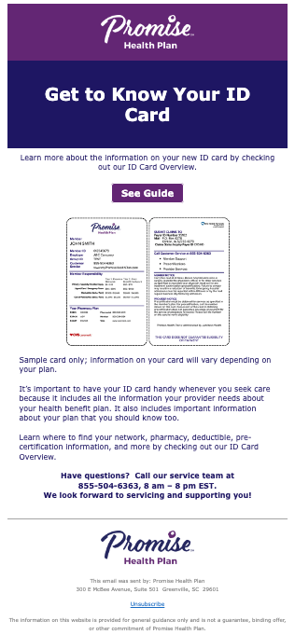
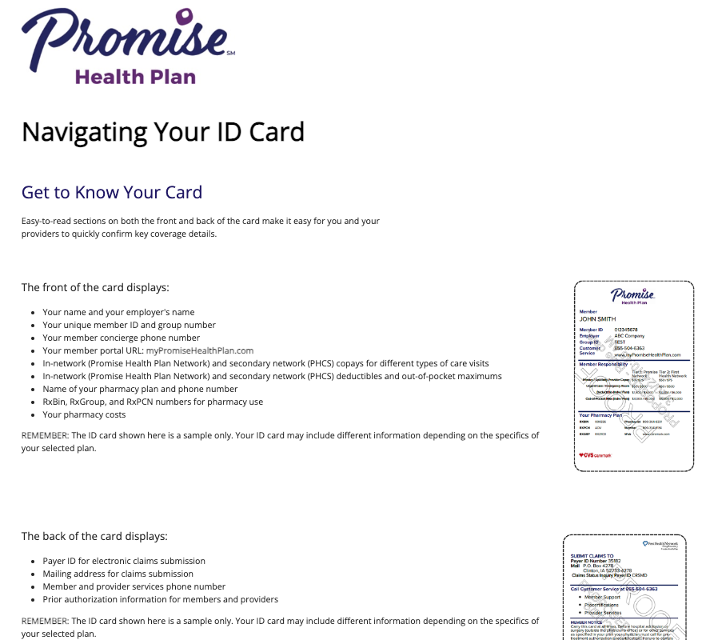
Email 2
ID card Tour
CTA = Navigating your id card landing page

Slide 9
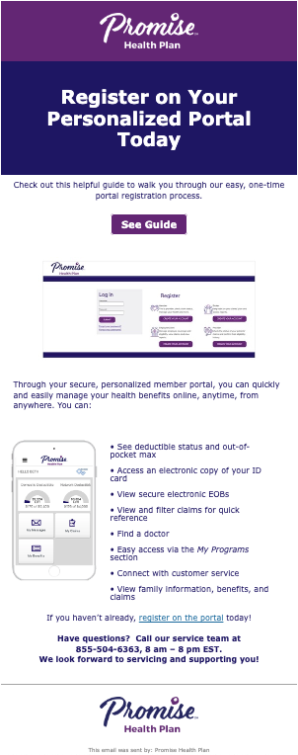
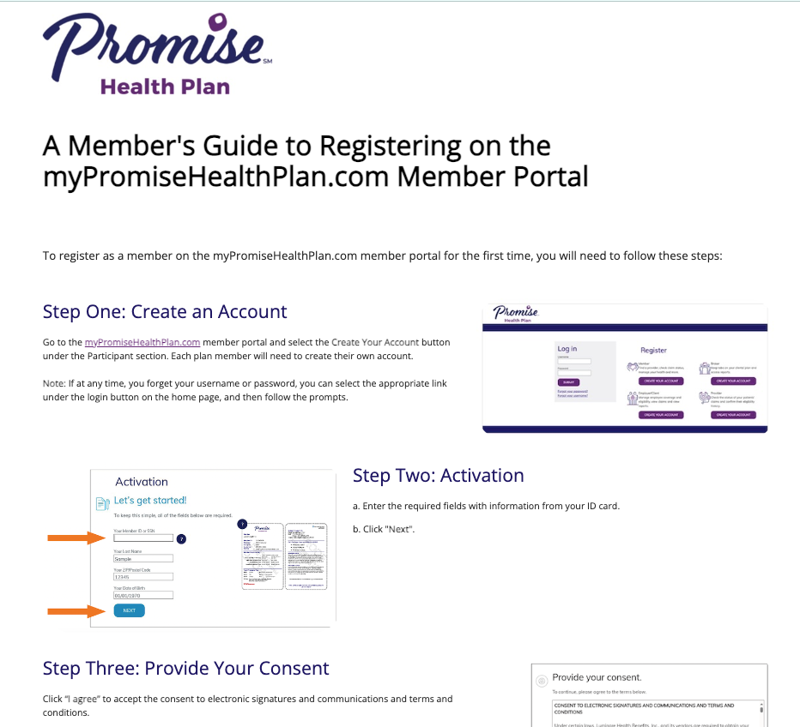
Email 3
Portal Registration
CTA = Member’s Guide to Registering Online
portal

Slide 10
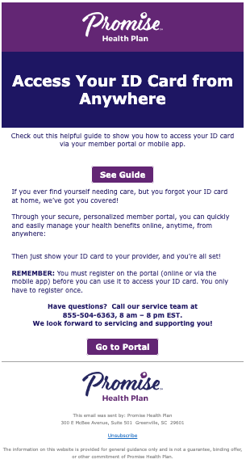
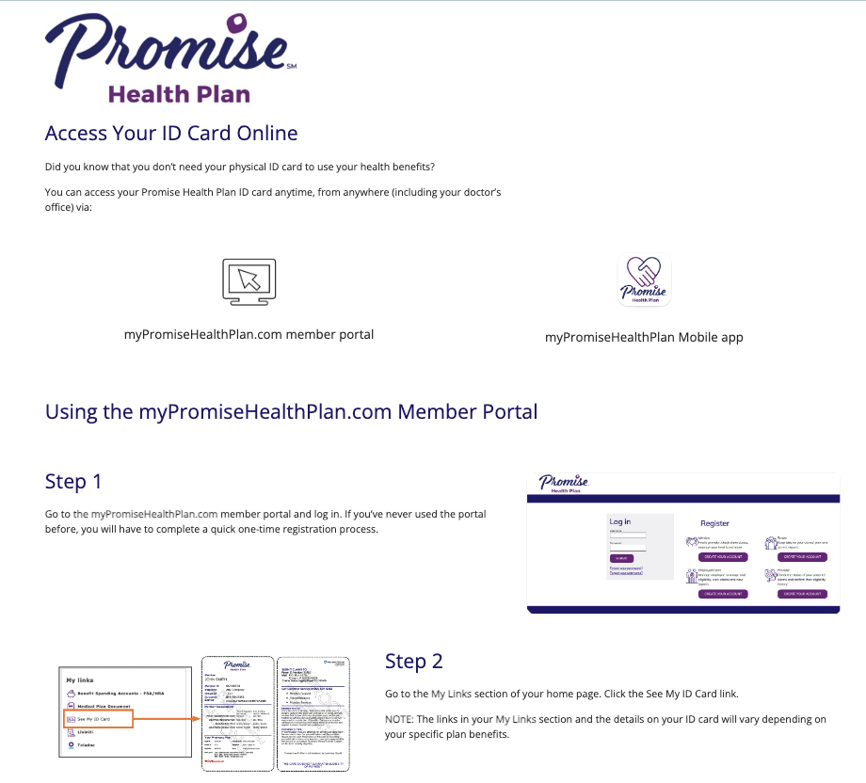
Email 4
Digital ID cards
CTA = Access Your ID card Online
Links to landing page & portal

Slide 11
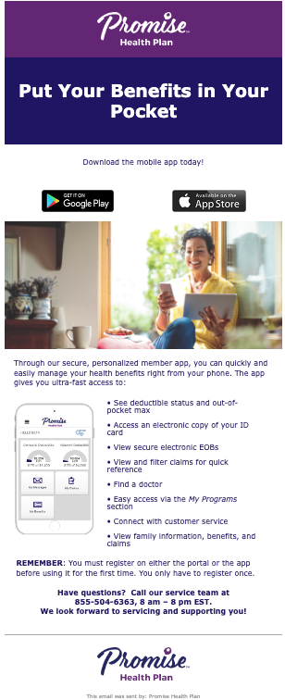
Email 5
Mobile app
CTA = Download your mobile app
  Google or Apple
Notes:
https://play.google.com/store/apps/details?id=com.coresource.ph&hl=en_US&gl=US. https://apps.apple.com/us/app/mypromisehealthplan-mobile/id6473550037

Slide 12
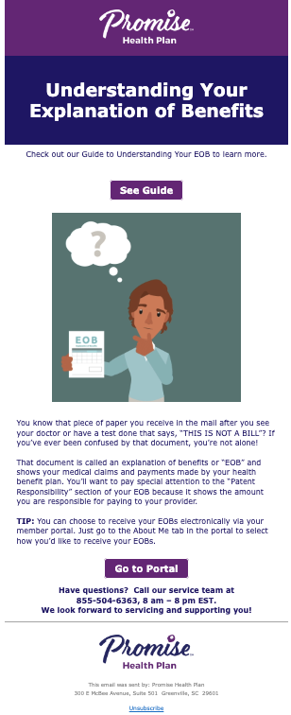
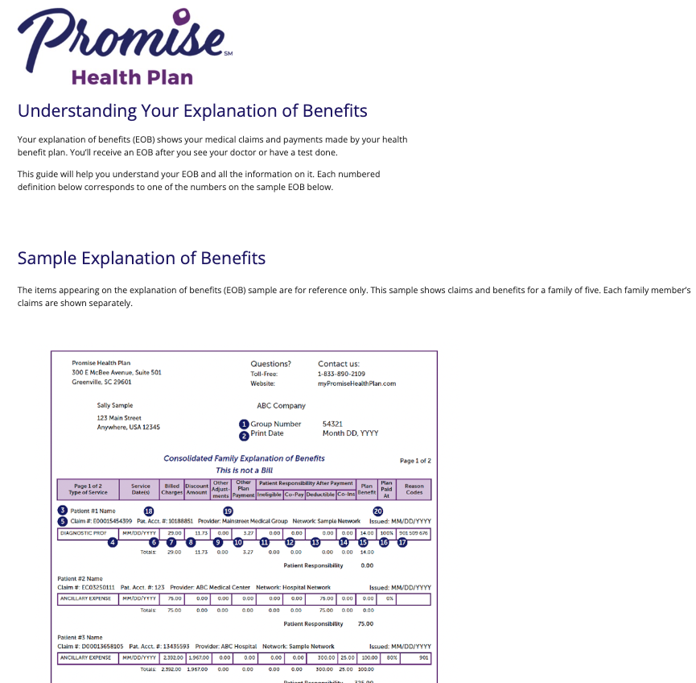
Email 6
Navigate your EOB
CTA = Understanding your Explanation of Benefits landing page
  2nd CTA = Portal

Slide 13
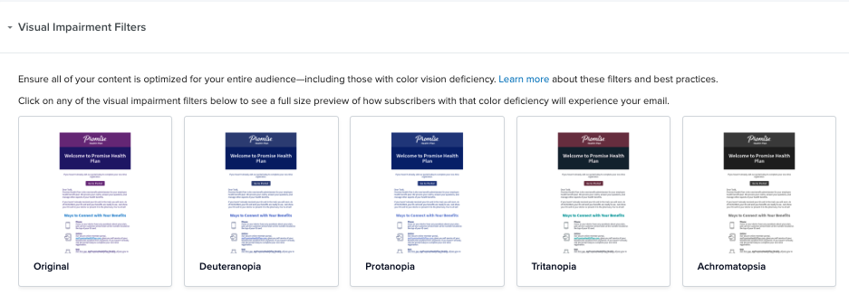
Visual Impairment Views

Slide 14
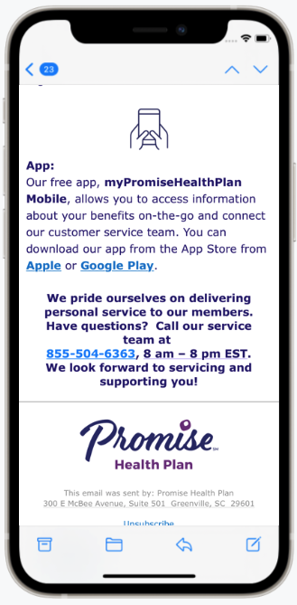
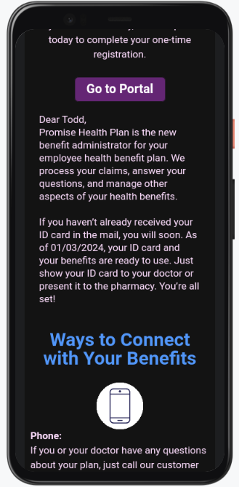
Mobile in dark vs light
Notes:
Dark mode will vary based on device viewer

