Slide 1

WELCOME
This presentation is for use ONLY for Tribal Communities with the Luminare Health Alternative Delivery Model.
See speaker notes below for instructions on customizing this presentation for your group.
to Open Enrollment 2026 PPO
Blue Cross and Blue Shield of Illinois, a Division of Health Care Service Corporation, a Mutual Legal Reserve Company, an Independent Licensee of the Blue Cross and Blue Shield Association
254108.1225
Notes:
Approved 12/25
EMI Team – Deborah Wells, Debb Bastian
Content approved by Debb Bastian
2026 PPO Open Enrollment Member Presentation should be customized for each use. Delete slides that do not apply and customize table data, dates, phone numbers, etc. as needed.
The file is divided into the following sections:
Introduction and PPO basics
Blue Distinction Centers
CDHPs
BlueEdge HSA
BlueEdge HCA
Digital Capabilities
myBlueElement
Health and Wellness Programs
Dental
Prescription Drugs
myVirtualCare Access

Slide 2
Why Use Blue?SM
DEBB
More Doctors
and Hospitals
Coverage
Everywhere You Go
Personalized
Customer Service
Health and
Wellness Programs
Tools and Resources
Digital
Capabilities
Notes:
Approved 12/25
EMI Team – Deborah Wells, Debb Bastian
Content approved by Debb Bastian
Coverage everywhere you go – in the U.S. and around the world (subject to plan conditions)
More doctors and hospitals than other carriers – more than 2 million doctors and hospitals nationwide
Health and Wellness programs that help you stay healthy and manage ongoing conditions
Digital/mobile technology and programs help you access and manage your health and wellness information
Unrivaled customer service – get personalized assistance with your questions, benefit and claim inquiries, and help finding a provider or navigating digital tools

Slide 3
Plan Options — What to Think About
DEBB
1
Provider availability
Will you be able to visit the doctors, hospitals and other facilities you want to?
Your costs
How much is going to come out of your paycheck every month? What about for the whole year?
Benefit payments
How much will you have to pay out of your pocket for your medical expenses?
Medical services
Consider your health status and services you expect to use during the year. What has your experience been in past years?
2
3
4
Notes:
Approved 12/25
EMI Team – Deborah Wells, Debb Bastian
Content approved by Debb Bastian

Slide 4

The strength of BlueSM
SHARON
ROBERTS
NUMBER 1
brand in health care
OVER 117 MILLION
members
MORE THAN
2 MILLION
unique, in-network providers
98%
of claims paid at in-network rates
Notes:
Approved 12/25
EMI Team – Deborah Wells, Debb Bastian
Content approved by Sharon Roberts
Blue Value Story Talking Points, BCBSA/BlueWeb (updated 3/25)
BCBS Plans have one of the largest hospital and physician networks in the U.S., with 97 percent of all U.S. hospitals and 83 percent of physicians.
Based on the actual claims experiences of our group clients, in-network discounts and total cost of care are still foundational BCBS strengths. Due to the market-leading breadth of our BlueCard network, more claims are in-network (98%) compared to our competitors (96%) leading to an overall lower cost of care.

Slide 5
PPO — How It Works
  In-Network Providers
ADVANTAGES
Receive the highest level of benefits and potentially pay less for care
Protection from billing over the allowed amounts (balance billing)
No claim forms (provider files claim)
No referrals required
No requirement to select a PCP
Access to a national PPO network
  Out-of-Network Providers
DRAWBACKS
  You do have coverage, but
You pay a greater share
of the costs
You may receive fewer
benefits out-of-network
You may need to file
your own claims
You may be billed for charges
over the allowed amount
(balance billing)
Notes:
Approved 12/25
EMI Team – Deborah Wells, Debb Bastian
Content approved by Chris Clowes
Participating Provider Option (PPO)
A health care plan that supplies services at a higher level of benefits when members use contracted health care providers. PPOs also provide coverage for services rendered by health care providers who are not part of the PPO network, however the plan member generally shares a greater portion of the cost for such services.
Primary Care Physician (PCP)
The physician you choose to be your primary source for medical care. In some health plans, your PCP coordinates all your medical care, including hospital admissions and referrals to specialists.

Slide 6
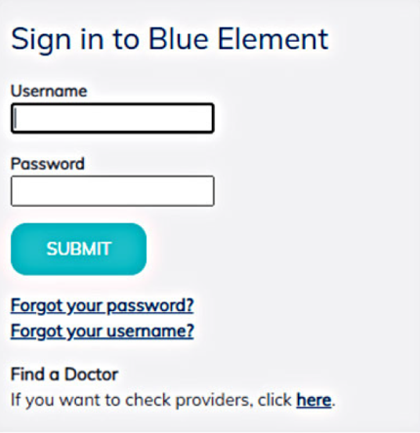

How to Find a PPO Provider
Remove this slide if group has an advocacy vendor.
JEFF K
From your computer or mobile
device, go to myBlueElementIL.com.
Under a Find a Doctor click here
to search for a provider
Call BlueCard® Access — available
24/7 at 800-810-2583
Speak with your provider’s office
Screen images are for illustrative purposes only.
Notes:
Approved 12/25
EMI Team: Deborah Wells / Debb Bastian
SME/Approver: Dyamond Battle, Vivian Jones, Gentry McKeown
Please note: Because this deck is for a pre-enrollment member audience, this slide shows how to access the public (non-authenticated) provider directory via the Find a Doctor link. Once enrolled, the member can login to access the authenticated provider directory, which will show results specific to their plan.

Slide 7

Customer Service
Remove this slide if group has an advocacy vendor.
JEFF K
Log on to myBlueElementIL.com
for information about:
  Claims
  Medical benefit coverage
  Finding network providers
  Membership and eligibility
  Navigating digital tools and resources
  ID card requests
  Health education and transfer to
  other health programs
  Transition of care
Notes:
Approved 12/25
EMI Team: Deborah Wells / Debb Bastian
SME/Approver: Dyamond Battle, Vivian Jones, Gentry McKeown

Slide 8
Your Benefits
Update with client-specific information.
JEFF K
Benefit | PPO Plan
 | In-Network | Out-of-Network
Individual Deductible | $300 | $600
Family Deductible | $600 | $1,200
Individual Out-of-Pocket Max | $1,500 | $3,000
Family Out-of-Pocket Max | $3,000 | $6,000
Office Visit | 90%* | 70%*
Preventive Care | 100% | 70%*
Inpatient Admission | 90%* | 70%*
Emergency Room | 90%*
All Other Covered Services | 90%* | 70%*
Retail Rx – Generic/Preferred/Non-Preferred | $5/$25/$50 | N/A
Mail Order Rx – Generic/Preferred/Non-Preferred | $10/$50/$100 | N/A
*After deductible
Notes:
Approved 12/25
EMI Team – Deborah Wells, Debb Bastian
Content approved by Chris Clowes

Slide 9
Benefits Comparison
Update with client-specific information.
Benefit | PPO Plan |  | BlueEdgeSM
 | In-Network | Out-of-Network | In-Network | Out-of-Network
Individual Deductible | $300 | $600 | $1,500 | $3,000
Family Deductible | $600 | $1,200 | $3,000 | $6,000
Tribal-Sponsored Plan/Employer HCA/HSA Contribution | N/A |  | $XXX
Individual Out-of-Pocket Max | $1,500 | $3,000 | $7,500 | $15,000
Family Out-of-Pocket Max | $3,000 | $6,000 | $15,000 | $30,000
Office Visit | 90%* | 70%* | 80%* | 60%*
Preventive Care | 100% | 70%* | 100% | 60%*
Inpatient Admission | 90%* | 70%* | 80%* | 60%*
Emergency Room | 90%* |  | 80%*
All Other Covered Services | 90%* | 70%* | 80%* | 60%*
Retail Rx – Generic/ Preferred/Non-Preferred | $5/$25/$50 | N/A | 80%* | N/A
Mail Order Rx – Generic/ Preferred/Non-Preferred | $10/$50/$100 | N/A | 80%* | N/A
*After deductible
Notes:
Approved 12/25
EMI Team: Deborah Wells / Debb Bastian
SME/Approver: Dyamond Battle, Vivian Jones, Gentry McKeown

Slide 10
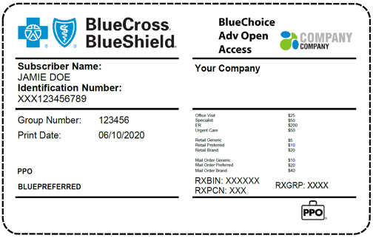
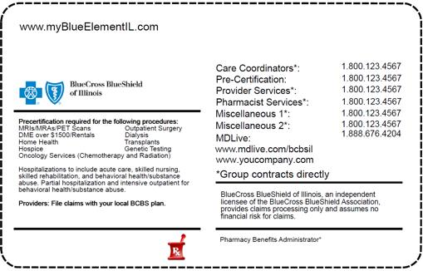
Your ID Cards
Update with client-specific information.
Two ID cards are provided for family coverage.
Log on to
myBlueElementIL.com
to order additional or replacement ID cards.
All employees will receive new ID cards.
You should receive your new ID cards by Month XX, 2025.
Sample for illustrative purposes only.
Notes:
Approved 12/25
EMI Team: Deborah Wells / Debb Bastian
SME/Approver: Dyamond Battle, Vivian Jones, Gentry McKeown
Order additional or replacement cards at myBlueElementIL.com:
Use this form to order an additional ID card or to replace a lost one. Your new ID card will be sent to you within two weeks. Please help us keep costs down by ordering ID cards only when needed.
PPO members' cards display the subscriber's name on all cards.

Slide 11
Transition of Care
Submit Transition of Care form prior to effective date. You will receive a decision by mail.
Completion of the form
is not a guarantee
of coverage.
Applies to you or your covered dependents
who will be in the middle of medical care on
Jan. 1, 2026, with a provider who is not part
of the network.
If approved, benefits would be paid at the
in-network level for a specified period of time
for those:
  Receiving cancer treatment/therapies
  Being treated for a terminal illness
  In their third trimester of pregnancy
  In cardiac rehabilitation
Notes:
Approved 12/25
EMI Team – Deborah Wells, Debb Bastian
Content approved by Chris Clowes

Slide 12
Blue Distinction® Specialty Care
JANICE
JULIE H
Notes:
Approved 12/25
EMI Team – Deborah Wells, Debb Bastian
Content approved by Josh Mann (Clinton Osifo)

Slide 13
Blue Distinction® Specialty Care Program
JANICE
JULIE H
Hospitals may all look the same, but there are often differences in the quality of care you receive depending on the facility you choose.
The choices you make matter when it comes to your health care.
Hospitals and medical facilities with superior expertise in delivering higher-quality health care
in at least one of the following specialties:
Knee and Hip
Replacement
Spine Surgery
Cardiac Care
Transplants
Bariatric Surgery
Maternity Care
CAR-T
Gene Therapy*
Fertility Care
Substance Use Treatment and Recovery
*The gene therapy program will be discontinued as of 7/1/26.
Notes:
Approved 12/25
EMI Team – Deborah Wells, Debb Bastian
Content approved by Josh Mann (Clinton Osifo)
Blue Distinction Specialty Care focuses on hospitals and other health care facilities that excel in delivering safe, effective treatment for specialty procedures, such as knee and hip replacements, cardiac care, bariatric (weight loss) surgery and transplants.
The choices you make matter – especially when it comes to your health care.
The hospital you select can have a direct impact on the care you receive and your procedure results. But finding the right hospital can sometimes be a challenge.
Uses patient safety and outcomes measures, plus hospital-specific cost data to identify expertise and efficient specialty care.
Launched in 2006, Blue Distinction is a national designation awarded by Blue Cross and Blue Shield companies to hospitals and medical facilities that have demonstrated expertise in delivering quality health care in the areas of bariatric surgery, cardiac care, CAR-T, fertility care, knee and hip replacement, maternity care, spine surgery, transplants and substance use treatment and recovery. The designation is based on objective, evidence-based selection criteria established in collaboration with expert physicians and medical organizations. The Blues focused first on high variability, high volume and/or complex procedures.
BDC designations are for BCBS-participating medical facilities (hospitals) only at this point; not for physicians or other individual providers.

Slide 14
Two Distinct Recognitions
JANICE
JULIE H
Blue Distinction® Centers and Blue Distinction® Centers+ have a proven history
of delivering exceptional care and results.
With two levels of recognition, you and your doctor can choose the option
that best meets your needs.
Blue Distinction Centers
Demonstrate quality care, treatment expertise and better overall patient results
Blue Distinction Centers+
Demonstrate more affordable care in addition to quality care, treatment expertise and better overall patient results
There are approximately 2,480 BDCs nationwide
Notes:
Approved 12/25
EMI Team – Deborah Wells, Debb Bastian
Content approved by Josh Mann (Clinton Osifo)
Enhancements to the Program
To address market needs the Blue Distinction program is transitioning from a quality-focused designation to a total value designation.
QUALITY:
Enhance existing selection criteria, with greater focus on:
Patient safety
Outcomes
Patient experience
Continuing to increase quality thresholds
COST:
Introduce cost of care measures into selection criteria
Quality comes first – cost of care criteria apply only if/after facility meets quality criteria

Slide 15
Specialty Care Benefits
Update with client-specific information. Relabel and/or remove rows as needed.
JANICE
JULIE H
Choose a Blue Distinction® facility for care in these specialties for the highest level of benefits.
TIERS OF COVERAGE
1. Blue Distinction® Center+
XX%
2. Blue Distinction® Center
XX%
3. PPO In-Network
XX%
4. Out-of-Network
XX%
Bariatric surgery
Cardiac care
Knee and hip replacement
Maternity care
Spine surgery
Transplants
CAR-T
Gene therapy*
Fertility care
Substance use
treatment and
recovery
*The gene therapy program will be discontinued as of 7/1/26.
Notes:
Approved 12/25
EMI Team – Deborah Wells, Debb Bastian
Content approved by Josh Mann (Clinton Osifo)
The choices you make matter – especially when it comes to your health care.
The hospital you select can have a direct impact on the care you receive and your procedure results. But finding the right hospital can sometimes be a challenge.
Launched in 2006, Blue Distinction is a national designation awarded by Blue Cross and Blue Shield companies to hospitals and medical facilities that have demonstrated expertise in delivering quality health care in the areas of bariatric surgery, cardiac care, CAR-T, fertility care, knee and hip replacement, maternity care, spine surgery, transplants and substance use treatment and recovery. The designation is based on objective, evidence-based selection criteria established in collaboration with expert physicians and medical organizations. The Blues focused first on high variability, high volume and/or complex procedures.
BDC designations are for BCBS participating medical facilities (hospitals) only at this point; not for physicians or other individual providers.
We use patient safety and outcomes measures, plus hospital-specific cost data to identify expertise and efficient specialty care.

Slide 16
Consumer-Directed Health Plans
SERINA
KENGIE
Notes:
Approved 12/25
EMI Team – Deborah Wells, Debb Bastian
Content approved by Kengie Vanderlaan
CDHP ─ Consumer-Directed Health Plan combines a health plan with a tax-advantaged account, such as an HSA.
HDHP ─ High Deductible Health Plan – An HSA-qualified High Deductible Health Plan is defined by IRS code as the following:
A higher annual deductible than typical health plans.
A maximum limit on the sum of the annual deductible and out-of-pocket medical expenses that are paid for covered expenses. Out-of-pocket expenses include copayments and other amounts, but do not include premiums.
May provide preventive care benefits without a deductible.

Slide 17
The Basics of Consumer-Directed Plans
What Does Consumer-Directed Health Care Look Like?
Consumer-directed plans have higher
deductibles than traditional PPO plans,
and typically lower employee contributions.
There are different types of accounts and different ways in which they can work:
Health Savings Account is a tax-advantaged bank account that is set up exclusively for the purpose of paying qualified medical expenses.
Health Care Account, also known as a Health Reimbursement Arrangement, is an account established and funded by your tribal-sponsored plan/employer to partially offset the deductible. HCA dollars are used to pay for qualified medical expenses.
Notes:
Approved 12/25
EMI Team – Deborah Wells, Debb Bastian
Content approved by Kengie Vanderlaan
HSA ─ Health Savings Account – The HSA is a tax-advantaged bank account that is set up exclusively for the purpose of paying qualified medical expenses.
HCA ─ Health Care Account, also known as a Health Reimbursement Arrangement (HRA), is an account established and funded by your employer to partially offset the deductible. HCA dollars are used to pay for qualified medical expenses.

Slide 18
BlueEdge HSASM
SERINA
KENGIE
Notes:
Approved 12/25
EMI Team – Deborah Wells, Debb Bastian
Content approved by Kengie Vanderlaan

Slide 19

What is a Health Savings Account?
A Health Savings Account is an individually owned, portable,
tax-advantaged account that only eligible individuals may establish.
An HSA is exclusively for paying qualified medical expenses.
Notes:
Approved 12/25
EMI Team – Deborah Wells, Debb Bastian
Content approved by Kengie Vanderlaan
Portability: A feature that allows the account to move with the employee when he or she leaves the company (only applies to HSA).
Carryover: Funds carry over from one year to the next and therefore are not subject to the "use it or lose it" rule.

Slide 20
Benefit Plan Options — Your Choice
Update with client-specific information.
SERINA
KENGIE
 | Pros | Cons
PPO | Full PPO network No referrals required Lower deductibles than HSA | Highest employee contributions No tax benefit No savings or balance possible
HSA | Same network access as PPO No referrals required HSA contributions are tax-free Can accumulate actual dollar balances Employee premium contributions typically lower than PPO Once deductible and out-of-pocket maximums are satisfied, all benefits, including pharmacy, must be paid at 100% | Higher deductible than PPO The deductible must be met before benefits are available for non-preventive services
Notes:
Approved 12/25
EMI Team – Deborah Wells, Debb Bastian
Content approved by Kengie Vanderlaan
The PPO provides access to the full PPO network. It has the lowest deductible but the highest employee premium.
(The HCA also provides access to the full PPO network. It has a higher deductible than the PPO but offsets the deductible with the health care account. The employee premium is much lower than the PPO.)
The HSA has the highest deductible but provides a savings account to offset the deductible. That money is yours to keep, whether you change plans later or leave the company. And it has the lowest employee premium. Bear in mind that you cannot have other coverage unless it is also a high deductible health plan, the full discounted cost of prescription drugs are subject to the deductible, and you are responsible for managing the savings account and reporting annually to the IRS.

Slide 21

Health Savings Account Basics
The Health Savings Account consists of two parts:
1
High Deductible
Health Plan
2
The Health
Savings Account
HSAs must be used in combination with a qualified High Deductible Health Plan such as the BlueEdge HSASM. With HDHPs:
A higher annual deductible applies
Out-of-pocket maximums apply only
to covered benefits
Preventive care benefits may be provided
without a deductible
Notes:
Approved 12/25
EMI Team – Deborah Wells, Debb Bastian
Content approved by Kengie Vanderlaan

Slide 22
How the HSA Works
  You will only have access to the amount that is in your account at the time of a
  claim — but you can save
  your receipt and repay
  yourself with funds
  contributed later in the year.
  With the exception of preventive care, all
  benefits, including
  pharmacy, must be
  subject to the plan
  deductible.
You own the account.
No “use it or lose it” rules — you keep the funds in your account if you leave the company or change plans.
Balances remaining in account at year end carry over to the following year.
Account earns interest and can be invested, over minimum balances.
Notes:
Approved 12/25
EMI Team – Deborah Wells, Debb Bastian
Content approved by Kengie Vanderlaan
Portability: a feature that allows the account to move with the employee when he or she leaves the company (only applies to HSA).

Slide 23
HSA Eligibility
To be an eligible individual and qualify for an HSA you:
Must be enrolled in an HSA-compatible High Deductible Health Plan
May not have other types of insurance with first-dollar medical coverage
May not be claimed as a dependent on another person’s tax return
May not be enrolled in Medicare
An individual can be Medicare-eligible and have an HSA. However, once enrolled in Medicare, contributions to the HSA account must stop. The individual can keep any funds in the account prior to enrolling in Medicare and use those funds to pay for qualified medical expenses tax-free.
Notes:
Approved 12/25
EMI Team – Deborah Wells, Debb Bastian
Content approved by Kengie Vanderlaan
Other first-dollar medical coverage examples include general purpose FSA, Medicaid, Medicare, Indian Health Service (IHS) and U.S. Department of Veterans Affairs (VA) coverage.

Slide 24
HSA Contributions
SERINA
KENGIE
The IRS determines the minimum/maximum amounts. The amounts are adjusted annually for inflation.
Employee, tribal-sponsored plan/employer or any other person may make contributions on behalf of an eligible individual.
U.S. Treasury Guidelines | 2025 Maximum HSA Contribution | 2026 Maximum HSA Contribution
Single Coverage | $4,300 | $4,400
Family Coverage | $8,550 | $8,750
Individuals aged 55 and older can make catch-up contributions: $1,000
Notes:
Approved 12/25
EMI Team – Deborah Wells, Debb Bastian
Content approved by Kengie Vanderlaan

Slide 25
Benefits Comparison
Update with client-specific information.
BlueEdge HSASM | PPO Plan
$500 Health Savings Account (employer-funded) | $500 Deductible (member responsibility)
$1,200 Health Savings Account (member-funded)
 | Member Share – PPO Benefits 20%
Member Share – PPO Benefits 20%
 | Copays
Maximum HSA contribution for 2026 is $4,400 for self-only coverage or $8,750 for family coverage.
Notes:
Approved 12/25
EMI Team – Deborah Wells, Debb Bastian
Content approved by Kengie Vanderlaan
Here's an example of how the HSA plan compares to a PPO. The HSA plan has an individual deductible of $1,700. You must establish an HSA account that you, your employer or anyone else can contribute to. Your employer contributes $500 per year to your HSA, which can be used toward the deductible. You are responsible for the remaining $1,200. Once the deductible is met you pay 20% coinsurance. As the HSA account grows, you can use those funds to pay your share of future expenses.
With the PPO, the individual deductible is $500. Once the deductible is met, you are responsible for 20% coinsurance and/or applicable copays.
Remember, your premium contribution is typically lower with an HSA plan and that HSA funds carry over from year to year, are portable and earn interest.

Slide 26

View HSA Account Information Online
SERINA
  With Health Equity or Flex, you
  can view your HSA account
  information online
  Check HSA account status
  View or print detailed history
  of HSA account transactions
  and balances
  Link to FAQs and more information about HSAs
HealthEquity is an independent company that has contracted with Blue Cross and Blue Shield of Illinois to provide banking and account administration for members with coverage through BCBSIL. Flexible Benefit Service Corporation is an independent company. The relationship between BCBSIL and FlexHSA is that of independent contractors. FlexHSA is solely responsible for the products and services it provides.
BCBSIL makes no endorsement, representations or warranties regarding third-party vendors and the products and services offered by them.
Notes:
Approved 12/25
EMI Team – Deborah Wells, Debb Bastian
Content approved by Kengie Vanderlaan
To access HSA information, log in at myBlueElementIL.com.

Slide 27
BlueEdge HCASM
SERINA
Notes:
Approved 12/25
EMI Team – Deborah Wells, Debb Bastian
Content approved by Kengie Vanderlaan, David Hoffman

Slide 28
How the Health Care Account Works
Also known as a Health Reimbursement Arrangement, an HCA is established and funded by your employer to partially offset your deductible.
You can use money from your HCA to pay for qualified medical expenses such as hospital stays and doctor’s office visits.
Your employer will set aside $XXX for employee-only coverage or $XXX for family coverage on an annual basis.
HCA dollars are used first to pay for qualified medical expenses. [OR bullet below; keep correct one]
HCA dollars will be available to pay for qualified medical expenses after the $XXX self-pay corridor has been satisfied.
Any balance remaining in the account at year-end will
roll over to the next year and be added to the following
year’s annual contribution.
Under family coverage, the entire amount in the HCA
can be applied to one family member’s expenses.
The account reverts to your employer if you change plans
or leave the company (unless you elect COBRA coverage).
Select correct frequency: a monthly | a quarterly |
a semi-annual | an annual
HCA Direct option
Remove bullet if rollover does not apply
Notes:
Approved 12/25
EMI Team – Deborah Wells, Debb Bastian
Content approved by Kengie Vanderlaan, David Hoffman
Rollover: an account feature that allows the balance left in an account to be added to the next year, which is then added to the employer’s annual contribution. Accumulated funds are applied to eligible claims.

Slide 29
BlueEdge HCASM
Use this slide if the standard BlueEdge HCA is offered.
SERINA
Funds set aside in the HCA help offset some or all
of the annual deductible and/or coinsurance.
ANNUAL DEDUCTIBLE
Your HCA automatically pays claims for covered services from in-network providers. It pays eligible expenses as they are applied to your deductible until the HCA account balance is depleted.
The portion of the deductible not covered by your HCA is your responsibility. This is called the self-pay corridor.
Once the deductible is satisfied, eligible expenses are paid at the appropriate PPO or non-PPO benefit levels until the out-of-pocket maximum is reached.
Preventive care is covered at 100%.
If your tribal-sponsored plan/employer offers rollover, your HCA can grow year over year up to the set maximum.
1
Health Care Account (Employer-Funded)
2
Member Responsibility
COINSURANCE
Member Responsibility %
3
BCBSIL Pays %
OUT-OF-POCKET MAXIMUM
BCBSIL Pays 100% of the Allowable Amount
Notes:
Approved 12/25
EMI Team – Deborah Wells, Debb Bastian
Content approved by Kengie Vanderlaan, David Hoffman
As your HCA grows, you have more funds to cover the deductible, partially or completely (only applies if the employer offers rollover).
Preventive care continues to be covered 100% in-network by the plan – no deductible, no copay.

Slide 30
BlueEdge HCA DirectSM
Use this slide if the standard BlueEdge Direct HCA is offered.
SERINA
Funds set aside in the HCA help offset some or all
of the annual deductible and/or coinsurance.
ANNUAL DEDUCTIBLE
The portion of the deductible not covered by your HCA is your responsibility. This is called the self-pay corridor.
Your HCA automatically pays claims for covered services from in-network providers after the self-pay corridor is met. It pays eligible expenses as they are applied to your deductible until the HCA account balance is depleted.
Once the deductible is satisfied, eligible expenses are paid at the appropriate PPO or non-PPO benefit levels until the out-of-pocket maximum is reached.
Preventive care is covered at 100%.
If your tribal-sponsored plan/employer offers rollover, your HCA can grow year over year up to the set maximum.
1
Member Responsibility
2
Health Care Account (Employer-Funded)
COINSURANCE
Member Responsibility %
3
BCBSIL Pays %
OUT-OF-POCKET MAXIMUM
BCBSIL Pays 100% of the Allowable Amount
Notes:
Approved 12/25
EMI Team – Deborah Wells, Debb Bastian
Content approved by Kengie Vanderlaan, David Hoffman
As your HCA grows, you have more funds to cover the deductible, partially or completely (only applies if the employer offers rollover).
Preventive care continues to be covered at 100% in-network by the plan – no deductible, no copay.

Slide 31
Benefits Comparison
Update with client-specific information.
BlueEdge HCASM | PPO Plan
$500 Health Care Account (employer-funded) | $500 Deductible (member responsibility)
$500 Self-Pay Corridor (member responsibility) | Member Share – PPO Benefits 20%
Member Share – PPO Benefits 20%
 | Copays
Notes:
Approved 12/25
EMI Team – Deborah Wells, Debb Bastian
Content approved by Kengie Vanderlaan, David Hoffman
Here's an example of how the HCA plan compares to a PPO. The HCA plan has an individual deductible of $1,000. Your employer establishes and funds an HCA account for you. Your employer contributes $500 per year to your HCA, which is applied toward the deductible. You are responsible for the remaining $500. Once the deductible is met, you pay 20% coinsurance.
With the PPO, the individual deductible is $500. Once the deductible is met, you are responsible for 20% coinsurance and/or applicable copays.
Remember, your premium contribution is typically lower with an HCA plan.

Slide 32

View HCA Account Information Online
SERINA
Check HCA account status
View or print detailed history of HCA account transactions and balances
Notes:
Approved 12/25
EMI Team – Deborah Wells, Debb Bastian
Content approved by Kengie Vanderlaan, David Hoffman
To access HCA information, log in at myBlueElementIL.com.

Slide 33
Digital Capabilities
LAUREN
Notes:
Approved 12/25
EMI Team: Deborah Wells, Debb Bastian
Reviewed by: Dyamond Battle, Vivian Jones, Gentry McKeown

Slide 34

You’re Mobile.
We’re Mobile.
LAUREN
We’ve got the tools
you need to access information from your mobile phone or device:
Member portal: myBlueElementSM
App: Blue Element Mobile IL*
*Access to all Blue Element app features will vary per user.
Notes:
Approved 12/25
EMI Team: Deborah Wells, Debb Bastian
Reviewed by: Dyamond Battle, Vivian Jones, Gentry McKeown

Slide 35
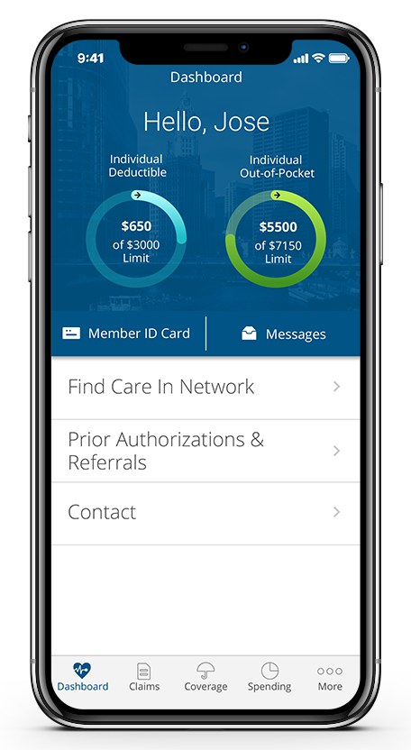

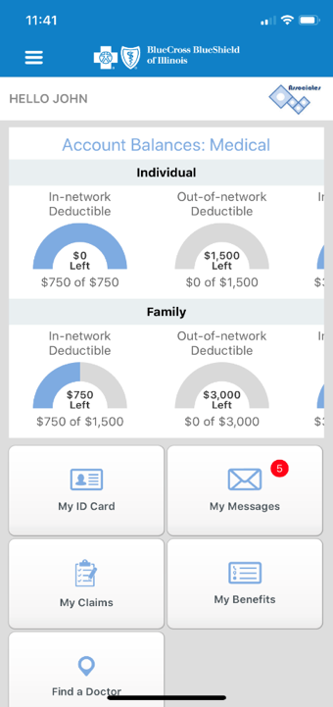

myBlueElementSM – Mobile App
By downloading the myBlueElement app, you can:
HELLO BETH
See the status of deductible and out-of-pocket maximum
Show ID card to provider
View and filter claims for quick reference
Find a doctor
Easily access member-specific services in your health benefit plan
View family info and
health benefits
Access important benefits information
Filter claims by dependent and type
Contact Customer Service through the mobile message center
Contact Customer
Service by phone
Blue Cross and Blue Shield of Illinois, a Division of Health Care Service
Download the app for free from
Apple or Google Play. Search for
Blue Element Mobile IL.
Illinois
Screen images are for illustrative purposes only.
Notes:
Approved 12/25
EMI Team: Deborah Wells, Debb Bastian
Reviewed by: Dyamond Battle, Vivian Jones, Gentry McKeown

Slide 36

Blue ElementSM App for Mobile Devices
Find an in-network doctor, hospital or urgent care facility or search for Spanish-speaking doctors
Access your claims, coverage and deductible information
Access temporary digital member ID card
Secure login with Face ID
(iOS only) and Fingerprint ID
Let us know your
communication preferences
Illinois
Download the app for free from
Apple or Google Play. Search for
Blue Element Mobile IL.
Screen images are for illustrative purposes only.
Notes:
Approved 12/25
EMI Team: Deborah Wells, Debb Bastian
Reviewed by: Dyamond Battle, Vivian Jones, Gentry McKeown

Slide 37
myBlueElementSM
Notes:
Approved 12/25
EMI Team: Deborah Wells, Debb Bastian
Reviewed by: Dyamond Battle, Vivian Jones, Gentry McKeown

Slide 38

Tools at Your Fingertips
SERINA
CHRIS
View, print, download or re-order your member ID card
Confirm your coverage and eligibility information
Find in-network doctors, hospitals
and other health care providers
Review claims for medical, pharmacy and dental services*
all in one place
*As applicable
*As applicable
Notes:
Approved 12/25
EMI Team: Deborah Wells, Debb Bastian
Reviewed by: Dyamond Battle, Vivian Jones, Gentry McKeown

Slide 39
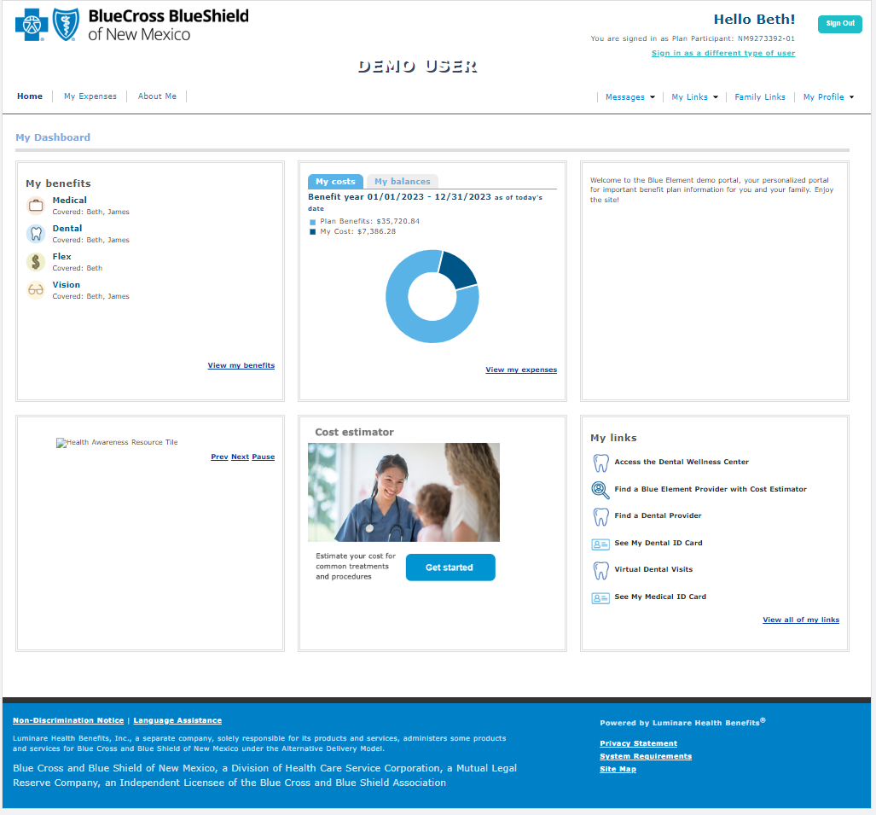

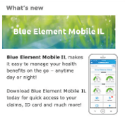
myBlueElementSM — Online Portal
myBlueElementIL.com
Easy navigation and customized content makes our member portal
user-friendly
Customized Dashboard Content
Your employer’s logo and greeting or other message
Links to find a doctor, see your ID card, access benefit offerings, view important documents and more, all tailored to you
Scrollable images to make you aware of available programs, health awareness resources and informational content
Information Important to You
Access to claim details and to view Explanation
of Benefits
Access to benefit details and booklets
Secure message center to communicate with Customer Service
Luminare Health Benefits, Inc., a separate company, solely responsible for its products and services, administers some products
and services for Blue Cross and Blue Shield of Illinois under the Alternative Delivery Model.
Blue Cross and Blue Shield of Illinois, a Division of Health Care Service Corporation, a Mutual Legal Reserve Company, an Independent Licensee of the Blue Cross and Blue Shield Association
Screen images are for illustrative purposes only.
Notes:
Approved 12/25
EMI Team: Deborah Wells, Debb Bastian
Reviewed by: Dyamond Battle, Vivian Jones, Gentry McKeown

Slide 40

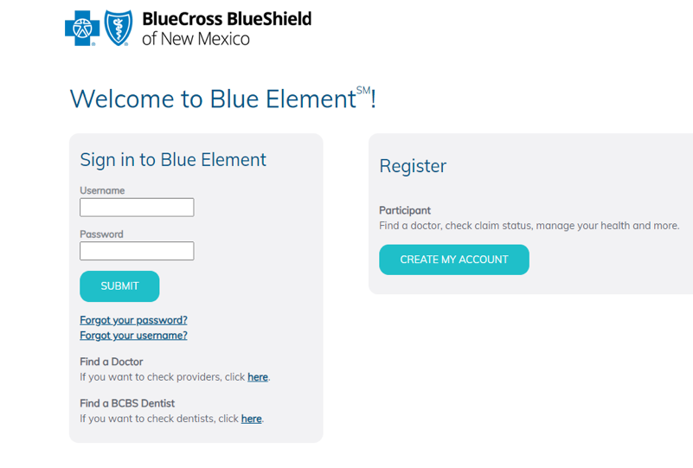
myBlueElementSM — Member Portal
myBlueElementIL.com
Access your benefits information anytime from our self-service member portal
Screen images are for illustrative purposes only.
Notes:
Approved 12/25
EMI Team: Deborah Wells, Debb Bastian
Reviewed by: Dyamond Battle, Vivian Jones, Gentry McKeown

Slide 41
Fast, Secure Access at Your Convenience
myBlueElementIL.com
Quickly view, filter and sort claims for easy reference
Check account balances
Create separate logins for family members
Contact Customer Service
Quickly view each family member’s coverage
View tailored messages
View secure electronic Explanation of Benefits
Screen images are for illustrative purposes only.
Notes:
Approved 12/25
EMI Team: Deborah Wells, Debb Bastian
Reviewed by: Dyamond Battle, Vivian Jones, Gentry McKeown

Slide 42
Member Dashboard
myBlueElementIL.com
Quick links to:
Opt in for fast electronic communications
Review your claims
and deductible and
out-of-pocket amounts
View your coverage
and dependent info
Ask a question
Easy access to:
Claim details and
Explanation of Benefits
Benefit details and booklets
Secure message center
to communicate with Customer Service
Luminare Health Benefits, Inc., a separate company, solely responsible for its products and services, administers some products
and services for Blue Cross and Blue Shield of Illinois under the Alternative Delivery Model.
Blue Cross and Blue Shield of Illinois, a Division of Health Care Service Corporation, a Mutual Legal Reserve Company, an Independent Licensee of the Blue Cross and Blue Shield Association
Screen images are for illustrative purposes only.
Notes:
Approved 12/25
EMI Team: Deborah Wells, Debb Bastian
Reviewed by: Dyamond Battle, Vivian Jones, Gentry McKeown

Slide 43
Health and Wellness
Slides in this section should be used ONLY for groups
with Clinical Health Solutions OR groups that have individual standalone offerings (as noted).
JESSICA
Notes:
Approved 12/25
EMI Team: Deborah Wells, Debb Bastian
Reviewed by: Dyamond Battle, Vivian Jones, Gentry McKeown

Slide 44
Your Health and Wellbeing Programs
Use this slide ONLY for groups with Clinical Health Solutions.
FIT BETTER HEALTH
INTO YOUR SCHEDULE
Well onTarget® helps you reach your health and wellness goals through online self-management programs and rewards.
Digital Mental Health supports your mental wellbeing with programs for stress, depression, sleep problems, panic and substance use.
24/7 Nurseline conveniently answers your health questions.
Women’s and Family Health provides support for cycle tracking, pregnancy and parenting.
Digital coaching programs help you manage your weight, diabetes, high blood pressure and joint and spine issues.
Log in at myBlueElementIL.com to access these resources and more.
Notes:
Approved 12/25
EMI Team – Deborah Wells, Debb Bastian
Content approved by Clara Henao, Margaux Herring, Samantha Hamilton
Your new health benefits include tools that can help you get healthier how and when it works for you.
Through myBlueElement you can access ‭resources to help you manage your health conditions, get ‭answers to health questions and reach your wellness goals.
For quick access to all your health and wellness resources, log in at myBlueElementIL.com.
‭========================
Well onTarget is a voluntary wellness program. Completion of the Health Assessment is not required for participation in the program.‭
Blue Points‭ Program Rules are subject to change without prior notice. See the Program Rules on the Well onTarget Member Wellness Portal at wellontarget.com for further information. Member agrees to comply with all applicable federal, state and local laws, including making all disclosures and paying all taxes with respect to their receipt of any reward.‭
24/7 Nurseline is not available to IL HMO members. For medical emergencies, call 911. This program is not a substitute for a doctor’s care. Talk to your doctor about any health questions or concerns.

Slide 45

Clinical Health Solutions
Use this slide ONLY for groups with Clinical Health Solutions.
Low-cost, high-value solutions that address your unique health care needs
Clinical Health Solutions
Health Management and Wellness
Behavioral Health Solutions
Teladoc Health® Chronic Condition Management Plus
Musculoskeletal Care
Women’s and Family Health
Cancer Support
AccessHope
Catapult
Catapult Health, Teladoc Health and AccessHope are independent companies that provide chronic disease prevention and health management solutions for
Blue Cross and Blue Shield of Illinois. BCBSIL makes no endorsement, representations or warranties regarding third-party vendors and the products and services offered by them.
Notes:
Revised 12/25
EMI Team: Deborah Wells, Debb Bastian
Reviewed by: Dyamond Battle, Vivian Jones, Gentry McKeown

Slide 46

Women’s and Family Health
Use this slide ONLY for groups with Clinical Health Solutions OR groups that have Ovia Health as a standalone.
SONYA
No matter what stage you are at in life’s journey, you should prepare as much as you can. We have tools to help — at no extra cost to you.
Ovia Health™ apps are your companion for the journey ahead: from cycle and fertility tracking to pregnancy, parenthood and menopause.
Well onTarget® offers self-guided courses that
help you plan for a healthy pregnancy and baby.
Plus, if your pregnancy is high-risk, you can find support from maternity specialists to help you care for yourself and your baby at myBlueElementIL.com.
Prepare for your life-changing journey.
Ovia Health is an independent company that has contracted with Blue Cross and Blue Shield of Illinois to provide maternity and family benefits solutions for members with coverage through BCBSIL. BCBSIL makes no endorsement, representations or warranties regarding third-party vendors and the products and services offered by them.
Notes:
Approved 12/25
EMI Team – Deborah Wells, Debb Bastian
Content approved by Angela Patterson, Clara Henao

Slide 47



Online Health Management and Wellness
Use this slide ONLY for groups with Clinical Health Solutions OR groups that have Onlife Health as a standalone.
Access convenient, cost-effective wellness tools
Get recommendations to help keep you up-to-date with care
Receive support in your wellness journey
With the Well onTarget® member portal you can:
Take a Health Assessment
Set personal health and wellness goals
Engage in self-management programs
Access online educational resources
Connect with a wellness coach
And much more
Take wellness on the go with the AlwaysOn mobile app. Available on Google Play and the Apple App Store.
AlwaysOn is owned and operated by Onlife Health Inc. an independent company that has contracted with Blue Cross and Blue Shield of Illinois
to provide digital health management for members with coverage through BCBSIL. BCBSIL makes no endorsement, representations or warranties regarding third-party vendors and the products and services offered by them.
Notes:
Approved 12/25
EMI Team: Deborah Wells, Debb Bastian
Reviewed by: Dyamond Battle, Vivian Jones, Gentry McKeown

Slide 48

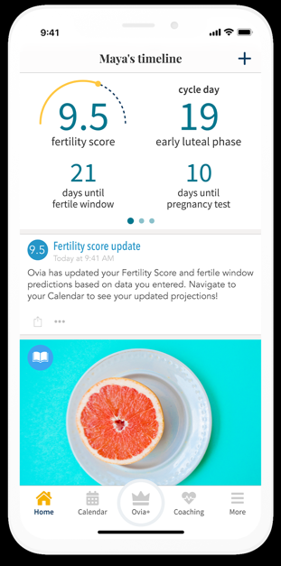

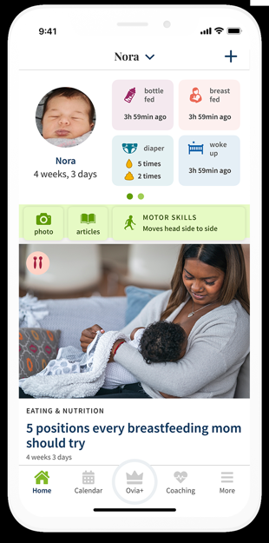

Ovia Supports Women’s Health
Use this slide ONLY for groups with Clinical Health Solutions OR groups that have Ovia Health as a standalone.
Fertility, Parenting and Menopause
Support for reproductive
health, fertility
and menopause
A go-to resource for parents of children ages
0-17
Ovia Health is an independent company that has contracted with Blue Cross and Blue Shield of Illinois to provide maternity and family benefits solutions for members with coverage through BCBSIL.
BCBSIL makes no endorsement, representations or warranties regarding third-party vendors and the products and services offered by them.
Screen images are for illustrative purposes only.
Notes:
Approved 12/25
EMI Team: Deborah Wells / Debb Bastian
Reviewed by: Dyamond Battle, Vivian Jones, Gentry McKeown
The Ovia solution supports women’s reproductive health through their apps – planning and starting a family, balancing life as a working parent, now including children up to the age of 17, and managing menopause.
Some of the key features of the solution are Health Assessments and symptom tracking.
This allows for alerts and predictive, personal coaching when Ovia detects a potential medical issue.
Physician-Developed Clinical Programs and Pathways.
Personalized health and wellness programs help members navigate infertility, mental health and more. This personalizes the content members see within their daily feed.
Unlimited 1-on-1 Coaching
Ability to message in-app instantly or schedule a phone or video call with Ovia registered nurse health coaches. Coaching hours are 8 a.m.-8 p.m. CT.

Slide 49


Hinge Health Digital Musculoskeletal Clinic
Use this slide ONLY for groups with Clinical Health Solutions OR groups that have Hinge Health as a standalone.
Hinge Health provides a complete solution —
for each stage of your MSK journey, with expert medical opinion
Prevention (at risk)
Job-specific exercises and education
Acute (recent injury)
Optional PT video visits for every body part
Chronic (high risk)
Exercise, education and behavioral change
Surgery (pre- and post-procedure)
Rehab for members who require surgery
Hinge Health will contact you about signing up
for the program that’s right for you
JESSICA
JEFFREY S
Not available with HMO networks
Hinge Health is an independent company that has contracted with Blue Cross and Blue Shield of Illinois to provide an online musculoskeletal program for members with coverage through BCBSIL.
BCBSIL makes no endorsement, representations or warranties regarding third-party vendors and the products and services offered by them.
Notes:
Approved 12/25
EMI Team – Deborah Wells, Debb Bastian
Content approved by Luke Nilles
Hinge Health provides the most complete end-to-end solution — offering the right program and care for different MSK needs.
Prevention: for members at-risk for MSK injury; personalized, job-specific exercises and education
Acute: for recovery from recent injury; PT video visits for every body part
Chronic: for those with long-term MSK pain, who may have high risk for surgery or other costly interventions; exercise, education and behavioral change
Surgery: pre- and post-procedure rehab for members who require surgery
Expert Medical Opinion available across all care programs
Hinge Health will contact you about how to sign up for the program that’s right for you.

Slide 50


Chronic Care Management Plus
Use this slide ONLY for groups with Clinical Health Solutions OR groups that have Teladoc Health CCMP as a standalone.
Teladoc Health®
If you have diabetes, prediabetes or hypertension, you can better manage additional weight, high cholesterol or behavioral health issues with options available through CCMP+.
You’ll receive a one-stop, personalized experience that adapts based on your needs.
Includes connected devices and access
to health coaches
Services covered — no out-of-pocket costs
If you are eligible, Teladoc Health will contact you about how to sign up for this program
Teladoc Health is an independent company that has contracted with Blue Cross and Blue Shield of Illinois to provide chronic condition management for members with coverage through BCBSIL. BCBSIL makes no endorsement, representations or warranties regarding third-party vendors and the products and services offered by them.
Notes:
Approved 12/25
EMI Team – Deborah Wells, Debb Bastian
Content approved by Jason Fry
Focused on diabetes, prediabetes and cardiovascular risk:
Lifestyle behavior change
Medication optimization
Emotional support
Provider coordination
Cellular-connected devices

Slide 51


Behavioral Health Support
Use this slide ONLY for groups with Clinical Health Solutions OR groups that have Headway as a standalone.
Greater Access and More Options at Your Fingertips
Personalized matching
Availability within 48 hours
In-person or virtual care
Specialist network of 60K+ therapists,
psychiatrists and psychologists
Easy-to-use platform
Affordable and transparent pricing
48
Headway is a separate company that has contracted with Blue Cross and Blue Shield of Illinois to provide behavioral health management for members with coverage through BCBSIL. BCBSIL makes no endorsement, representations or warranties regarding third-party vendors and the products and services offered by them.
Notes:
Approved 12/25
EMI Team: Deborah Wells, Debb Bastian
Reviewed by: Dyamond Battle, Vivian Jones, Gentry McKeown
Use the Behavioral Health Provider Finder to find in-network providers using search criteria based on member preference and member-matching criteria along with an appointment scheduler.

Slide 52

Take Care of Your Mental Health
Use this slide ONLY for groups with Clinical Health Solutions OR groups that have Headway as a standalone.
LISA M
Your plan includes behavioral health benefits so you and your covered family members can get support for:
Anxiety
Autism
Depression
Substance use disorder
Eating disorders
And other mental health conditions
Log in at myBlueElementIL.com or call the
number on the back of your member ID card to
find a counselor, psychiatrist or treatment center.
Notes:
Approved 12/25
EMI Team – Deborah Wells, Debb Bastian
Content approved by Jessica Doyle, Tara Fitzgerald, Chris Segura

Slide 53

Cancer Services and Support
Use this slide ONLY for groups with Clinical Health Solutions (NOT available as a standalone).
DEBB
A cancer diagnosis can change your life forever.
We are here to help.
The Cancer Services and Support program will give you the tools, resources and expert advice to help you before, during and after cancer treatment.
Cancer Support: Our skilled cancer care nurses are on hand to help you prepare for doctor office visits, share treatment information or give emotional support —
wherever you are in your cancer journey.
Expert Review and Support: If you are actively undergoing treatment or a cancer survivor, you can ask that a medical expert review your case. This allows you to get expert recommendations and clinical trial matches while staying close to home.
Cancer care nurse support is available today by calling the number on the back of your member ID card.
Notes:
Approved 12/25
EMI Team – Deborah Wells, Debb Bastian
Content approved by Morgan Ferrell, Jessica Brewer, Sarah Brown

Slide 54
Dental
Notes:
Approved 12/25
EMI Team: Deborah Wells, Debb Bastian
Reviewed by: Gail Gable, Theresa Arreola
You have the same Blue Element digital experience for dental as for medical.

Slide 55



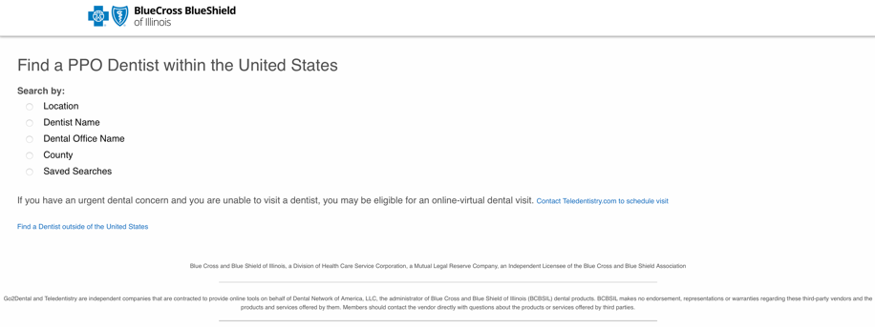
BlueCare DentalSM – Why It’s the Right Choice
Network
The largest national dental network in the U.S. with over 13,000 unique providers*
Service
Dental-only customer service
and claims units
Integration with Medical Benefits
Search for a provider in Illinois or nationally at myBlueElementIL.com.
Log in and go to “My links.”
Luminare Health Benefits, Inc., a separate company, solely responsible for its products and services, administers some products
and services for Blue Cross and Blue Shield of Illinois under the Alternative Delivery Model.
Blue Cross and Blue Shield of Illinois, a Division of Health Care Service Corporation, a Mutual Legal Reserve Company, an Independent Licensee of the Blue Cross and Blue Shield Association
*Network360® Analytics Suite (September 2025).
Screen images are for illustrative purposes only.
Notes:
Approved 12/25
EMI Team: Deborah Wells, Zach Buhnerkemper, Debb Bastian
Reviewed by: Gail Gable, Theresa Arreola

Slide 56
BlueCare Dental PPOSM
National Network* of Unique Providers
WA
4,295
NH
382
MT
349
ND
293
VT
343
ME
327
OR
1,846
MN
2,992
MA
6,034
Total
Unique Dental Providers:
153,730
ID
1,177
SD
133
WI
2,827
NY
10,142
WY
259
MI
4,398
RI
629
NV
2,363
NE
1,170
IA
1,700
PA
7,553
NJ
6,631
CT
2,419
UT
2,657
IL
6,896
OH
4,832
CO
4,208
IN
2,907
DE
193
CA
23,143
KS
1,582
MO
3,059
WV
586
VA
5,478
KY
2,375
DC
709
MD
4,586
TN
3,348
NC
4,229
AZ
5,059
NM
1,233
OK
1,987
AR
1,404
SC
2,125
MS
792
AL
1,706
GA
4,078
AK
369
TX
15,162
LA
1,486
FL
12,076
U.S. Virgin Islands
9
HI
1,078
Puerto Rico
256
*Network360® Analytics Suite (September 2025).
Notes:
Approved 12/25
EMI Team: Deborah Wells, Zach Buhnerkemper, Debb Bastian
Reviewed by: Gail Gable, Theresa Arreola
State data are ‘UNIQUES’
Unique Providers: Dentist/Specialist (belly button)
Unique Locations: A physical place you can go for dental services, a physical business (door knob)
Access Points: All the points where the dentist works (multiple office locations) (belly button x door knob = access points)
(This number may be inflated due to DSOs, where the provider may be aligned with each DSO’s unique office location even though they may only work at 1 or 2 locations.)

Slide 57

Access and Choice
BlueCare Dental PPOSM offers you flexibility.
You may receive coverage for services from any licensed dentist in the United States. But, with an in-network dentist discounts will apply for covered services.
Advantages of choosing an in-network dentist:
  Lower out-of-pocket costs for covered services, in most cases
  No balance billing
  No referral required for specialty dentists
  Contracting dentists will submit a claim on your behalf
If you choose an an out-of-network dentist:
  Your out-of-pocket costs may be higher
  You may have to file your own claims
  Your dentist may bill you for charges over a certain amount
Notes:
Approved 12/25
EMI Team: Deborah Wells, Debb Bastian
Reviewed by: Gail Gable, Theresa Arreola
BlueCare DentalSM offers you flexibility in choosing a dentist.
With BlueCare Dental PPO, you may receive coverage for services obtained from any licensed dentist in the United States. However, when you select an in-network dentist, the network offers negotiated discounts for covered services – which is why networks are so important when choosing a dental plan. Now that’s something to smile about!
Choosing an in-network dentist has many advantages:
• Lower out-of-pocket costs for covered services, in most cases
• No bill for the amount not covered by your insurance plan
• No referral required for specialty dentists
• Contracting dentists will submit a claim on your behalf
When an in-network dentist is selected, the network offers negotiated discounts for covered services and promises not to bill you for the amount not covered by your insurance plan.
Contracted Dental Providers
Your out-of-pocket costs will generally be the least amount because these providers have contracted with BCBSIL to accept a discounted rate
You are not required to file claims
You will not be balanced-billed over the allowable discounted rate
Non-Contracted Dental Providers
Your out-of-pocket costs may be greater because non-contracted providers have not entered into a contract with BCBSIL to accept a discounted rate
You may have to file claims
You may be balance-billed for costs exceeding the 90th percentile

Slide 58

Finding a Dentist is Easy
Our online directories allow you to browse at your convenience:
Log in at myBlueElementIL.com and click “Find a Dental Provider” under “My links”
You can create personalized directories based on provider specialty, distance and/or language; provider data is updated weekly and can be emailed or printed
You may also call the toll-free Customer Service number on the back of your ID card
Notes:
Approved 12/25
EMI Team: Deborah Wells, Debb Bastian
Reviewed by: Gail Gable, Theresa Arreola
You may access our directories by visiting Blue Element at myBlueElementIL.com and accessing the online Provider Finder or by calling the toll-free Customer Service number found on the back of every ID card.
Provider Finder lets you create personalized provider directories based on provider specialty, address or mileage preferences. Provider data is updated weekly and can be emailed or printed.

Slide 59
Prescription Drugs
Use this section ONLY for groups with Pharmacy.
KAROLYN
DAWN S
Notes:
Approved 12/25
EMI Team – Deborah Wells, Debb Bastian
Content approved by Karolyn Farkas

Slide 60

Prescription Drug Benefit
KAROLYN
DAWN S
Retail Pharmacy Network
  Major pharmacy chains
  Pharmacy search available online
Home Delivery (Mail Order)
  Up to a 90-day supply
  Convenience and savings
If FDA-approved dosing regimens exceed a 30-day supply limit, members may get a specialty drug in a greater supply amount, per benefits allowed. Cost share is based on the actual day supply dispensed.
Notes:
Approved 12/25
EMI Team – Deborah Wells, Debb Bastian
Content approved by Karolyn Farkas
AE/Presenter: Review the points above as they apply to your group and edit as needed.
For groups that have the mandatory specialty pharmacy benefit, up to a 30-day supply of covered specialty medication, except for certain FDA-designated dosing regimens, can be obtained through approved specialty pharmacies.
If FDA-approved dosing regimens exceed a 30-day supply limit, members may get a specialty drug in a greater supply amount, per benefits allowed. Cost share is based on the actual day supply dispensed.

Slide 61

3-Tier Prescription Drug Benefit
Update with client-specific information.
KAROLYN
DAWN S
Drug List Status | Retail Pharmacy Copay/Coinsurance (up to a 30-day supply) | Home Delivery (Mail Order) Copay/Coinsurance (up to a 90-day supply)
Generic | $X/X% | $X/X%
Preferred Brand | $XX/X% | $XX/X%
Non-Preferred Brand | $XX/X% | $XX/X%
Notes:
Approved 12/25
EMI Team – Deborah Wells, Debb Bastian
Content approved by Karolyn Farkas
Several prescription drug benefit options are included in the master deck. Use the slide that applies to your group and customize the copay/coinsurance columns.
Some ASO plans (and some custom fully insured plans) may have 90-day supply Retail benefits, based on network type selection. If part of the plan benefits, the member may pay 3x the 30-day supply retail cost at the pharmacy for their prescription. This is only for non-specialty medications.

Slide 62
4-Tier Prescription Drug Benefit
Update with client-specific information.
KAROLYN
DAWN S
Drug List Status | Retail Pharmacy Copay/Coinsurance (up to a 30-day supply) | Home Delivery (Mail Order) Copay/Coinsurance (up to a 90-day supply)
Generic | $X/X% | $X/X%
Preferred Brand | $XX/X% | $XX/X%
Non-Preferred Brand | $XX/X% | $XX/X%
 | Specialty Pharmacy (30-day supply)
Specialty* | $XX/X%
*Your plan may require that you use select specialty pharmacies to receive coverage for these medications.
Only a 30-day supply may be obtained at a time, except for certain FDA-designated dosing regimens. See your benefit booklet for details.
Notes:
Approved 12/25
EMI Team – Deborah Wells, Debb Bastian
Content approved by Karolyn Farkas
Several prescription drug benefit options are included in the master deck. Use the slide that applies to your group and customize the copay/coinsurance columns.
Some ASO plans (and some custom fully insured plans) may have 90-day supply Retail benefits, based on network type selection. If part of the plan benefits, the member may pay 3x the 30-day supply retail cost at the pharmacy for their prescription. This is only for non-specialty medications.

Slide 63
5-Tier Prescription Drug Benefit
Update with client-specific information.
KAROLYN
DAWN S
Drug List Status | Retail Pharmacy Copay/Coinsurance (up to a 30-day supply) | Home Delivery (Mail Order) Copay/Coinsurance (up to a 90-day supply)
Preferred Generic | $X/X% | $X/X%
Non-Preferred Generic | $XX/X% | $XX/X%
Preferred Brand | $XX/X% | $XX/X%
Non-Preferred Brand | $XX/X% | $XX/X%
 | Specialty Pharmacy (30-day supply)
Specialty* | $XX/X%
*Your plan may require that you use select specialty pharmacies to receive coverage for these medications.
Only a 30-day supply may be obtained at a time, except for certain FDA-designated dosing regimens. See your benefit booklet for details.
Notes:
Approved 12/25
EMI Team – Deborah Wells, Debb Bastian
Content approved by Karolyn Farkas
Several prescription drug benefit options are included in the master deck. Use the slide that applies to your group and customize the copay/coinsurance columns.
Some ASO plans (and some custom fully insured plans) may have 90-day supply Retail benefits, based on network type selection. If part of the plan benefits, the member may pay 3x the 30-day supply retail cost at the pharmacy for their prescription. This is only for non-specialty medications.

Slide 64
6-Tier Prescription Drug Benefit
Update with client-specific information.
KAROLYN
DAWN S
Drug List Status | Retail Pharmacy Copay/Coinsurance (up to a 30-day supply) | Home Delivery (Mail Order) Copay/Coinsurance (up to a 90-day supply)
Preferred Generic | $X/X% | $X/X%
Non-Preferred Generic | $XX/X% | $XX/X%
Preferred Brand | $XX/X% | $XX/X%
Non-Preferred Brand | $XX/X% | $XX/X%
 | Specialty Pharmacy (30-day supply)
Preferred Specialty* | $XX/X%
Non-Preferred Specialty* | $XX/X%
*Your plan may require that you use select specialty pharmacies to receive coverage for these medications.
Only a 30-day supply may be obtained at a time, except for certain FDA-designated dosing regimens. See your benefit booklet for details.
Notes:
Approved 12/25
EMI Team – Deborah Wells, Debb Bastian
Content approved by Karolyn Farkas
Several prescription drug benefit options are included in the master deck. Use the slide that applies to your group and customize the copay/coinsurance columns.
Some ASO plans (and some custom fully insured plans) may have 90-day supply Retail benefits, based on network type selection. If part of the plan benefits, the member may pay 3x the 30-day supply retail cost at the pharmacy for their prescription. This is only for non-specialty medications.

Slide 65
Prescription Drug Benefit
Preferred Pharmacy Network
Update with client-specific information.
KAROLYN
DAWN S
Drug List Status | Preferred Retail Pharmacy Copay/Coinsurance (up to a 30-day supply) | Non-Preferred Retail Pharmacy Copay/Coinsurance (up to a 30-day supply) | Preferred Retail Pharmacy Copay/ Coinsurance (up to a 90-day supply) | Home Delivery (Mail Order) Copay/Coinsurance (up to a 90-day supply)
Preferred Generic | $X/X% | $X/X% | $X/X% | $X/X%
Non-Preferred Generic | $XX/X% | $XX/X% | $XX/X% | $XX/X%
Preferred Brand | $XX/X% | $XX/X% | $XX/X% | $XX/X%
Non-Preferred Brand | $XX/X% | $XX/X% | $XX/X% | $XX/X%
 | Specialty Pharmacy (30-day supply)
Specialty Drugs* | $XX/X%
*Your plan may require that you use select specialty pharmacies to receive coverage for these medications.
Only a 30-day supply may be obtained at a time, except for certain FDA-designated dosing regimens. See your benefit booklet for details.
Notes:
Approved 12/25
EMI Team – Deborah Wells, Debb Bastian
Content approved by Karolyn Farkas
Several prescription drug benefit options are included in the master deck. Use the slide that applies to your group and customize the copay/coinsurance columns.
If the group has this preferred pharmacy network, just include this slide rather than include a tiered-benefit slide (i.e. 3-, 4-, 5- or 6-tier).
A “preferred” or “participating” pharmacy has a contract with BCBSIL or BCBSIL’s pharmacy benefit manager (Prime Therapeutics) to provide pharmacy services at a negotiated rate. The terms “preferred” and “participating” should not be construed as a recommendation, referral or any other statement as to the ability or quality of such pharmacy.

Slide 66
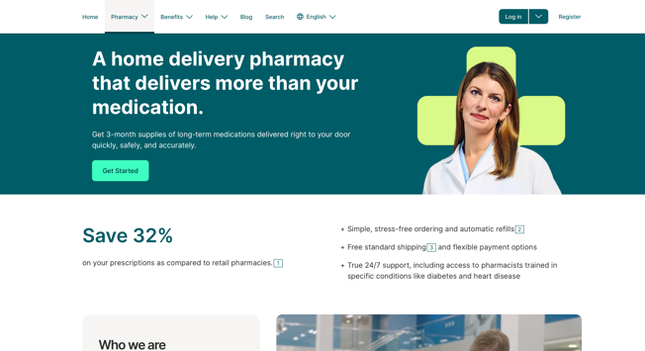
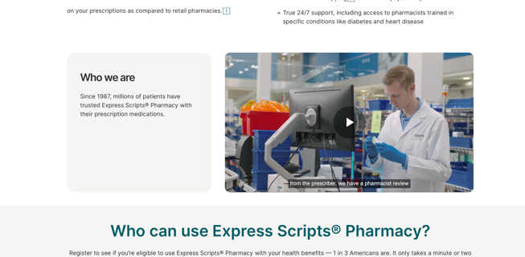
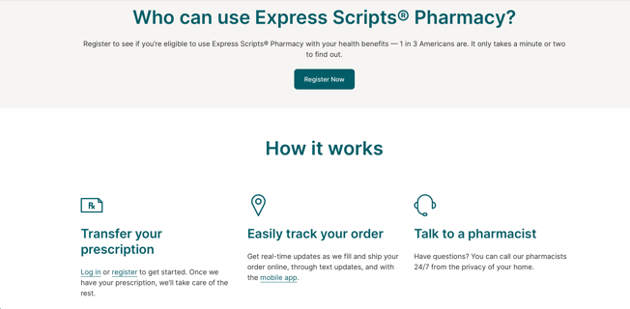
Home Delivery Prescriptions
KAROLYN
DAWN S
  Your pharmacy benefit includes mail order service
  of your maintenance medications from Express Scripts® Pharmacy.
  Register online at express-scripts.com/rx
  or by phone at 833-715-0942
  Once registered, ask your doctor to submit
  your prescription electronically or by fax
  Transfer your existing prescription from
  a retail pharmacy online or by phone
Based on your benefit plan, you may be able to use other in-network pharmacies. Check your plan materials for details, or call the customer service phone number on your
Member ID card.
Prime Therapeutics LLC is a separate company contracted by Blue Cross and Blue Shield of Illinois to provide pharmacy solutions. BCBSIL, as well as several other independent
Blue Cross and Blue Shield Plans, has an ownership interest in Prime Therapeutics.
Express Scripts® Pharmacy is a pharmacy that is contracted to provide mail pharmacy services to members of Blue Cross and Blue Shield of Illinois. The relationship between Express Scripts® Pharmacy and BCBSIL is that of independent contractors. Express Scripts® Pharmacy is a trademark of Express Scripts® Strategic Development, Inc.
Screen images are for illustrative purposes only.
Notes:
Approved 12/25
EMI Team – Deborah Wells, Debb Bastian
Content approved by Karolyn Farkas

Slide 67
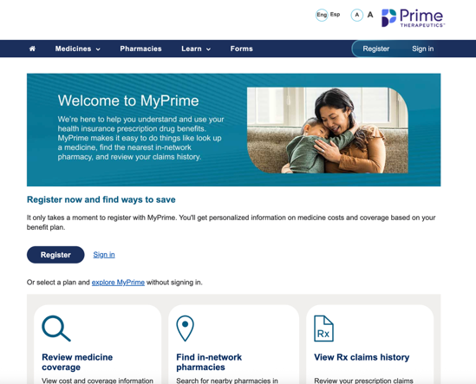
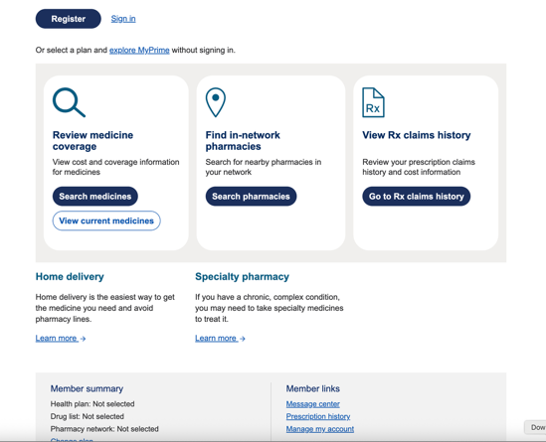
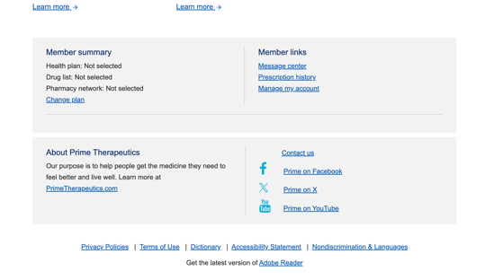
MyPrime.com
KAROLYN
DAWN S
Single sign-on from
myBlueElementIL.com to:
Locate a pharmacy
Find drugs/drug list
View prescription claim history
Create personal medicine list
Learn about specific drugs
  Rx cost calculator
  Health information
MyPrime.com is a pharmacy benefit website offered by Prime Therapeutics LLC.
Prime Therapeutics LLC is a separate company contracted by Blue ‭Cross and Blue Shield of Illinois to provide pharmacy solutions. In addition, ‭contracting pharmacies are contracted through Prime Therapeutics. The ‭relationship between BCBSIL and contracting pharmacies is that of independent ‭contractors. BCBSIL, as well as several independent Blue Cross and Blue ‭Shield Plans, has an ownership interest in Prime Therapeutics.
Screen images are for illustrative purposes only.
Notes:
Approved 12/25
EMI Team – Deborah Wells, Debb Bastian
Content approved by Karolyn Farkas
Locate a pharmacy
Find drugs/drug list
View prescription claim history
Create personal medicine list
Learn about specific drugs
Rx cost calculator
Health information

Slide 68
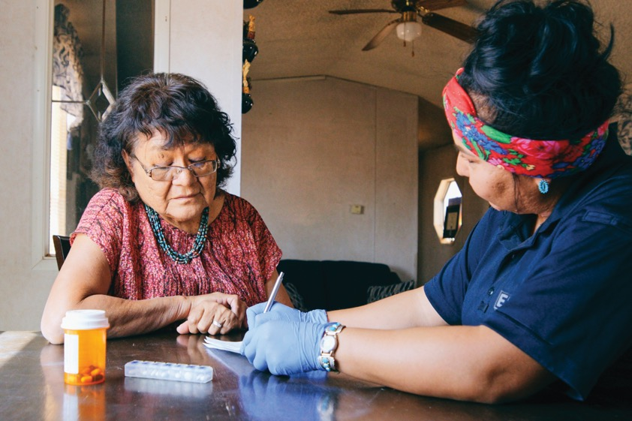

Prior Authorization
KAROLYN
DAWN S
The PA program promotes safe and appropriate medicine use.
If you are taking a drug that is part of the PA program, you will need to have your doctor submit a prior authorization request to
Blue Cross and Blue Shield of Illinois.
If approved, you will pay your share for
the drug, based on your benefit plan.
If not approved, the drug will not be covered.
  You may still fill the prescription, but you may
  be responsible for the full amount charged by
  the pharmacy.
Remember: Treatment decisions are always between you and your doctor, and cost is only one factor. Only you and your doctor can decide which medicine is right for you.
Notes:
Approved 12/25
EMI Team – Deborah Wells, Debb Bastian
Content approved by Karolyn Farkas
The Prior Authorization program encourages safe and effective drug use for certain drugs. It is designed to promote patient safety and use of the drug as intended by the manufacturer and the FDA. Before medicines in the PA program can be covered under your pharmacy benefit plan, your doctor will need to get an approval through BCBSIL.
Please note: Select drugs that are new to the market may also need prior authorization.
Prior Authorization (PA) – If your drug is part of the PA program, you will need to have your doctor submit pre-approval (also known as a prior authorization request) to BCBSIL.
If your request is approved, you will pay your share of the drug, based on your benefit plan.
If your request is not approved, the drug will not be covered. You may still fill the prescription, but you may have to pay the full amount charged by the pharmacy.
Call the number on the back of your ID card for questions about a certain drug.
The member can find out if their drug requires a PA by reviewing the drug list posted at myprime.com or using one of the digital tools (myBlueElement app or MyPrime.com). The approval is generally good for up to one year and most will require the doctor to re-submit the request before the approval expiration to continue receiving coverage. Some drugs may automatically be approved and/or renewed for prior authorization.

Slide 69

Step Therapy
KAROLYN
DAWN S
This program requires a “step” approach before you may receive coverage for certain high-cost medicines.
You may need to use a safe, cost-effective, first-line
drug before your benefit plan may cover another less preferred, second-line medicine included in the step
therapy program.
If you and your doctor determine no alternate drug
(including any available generic equivalent) is right
for you, your doctor may submit a step therapy
exception request for coverage consideration of
your current medicine.
Remember: Treatment decisions are always between you and your doctor, and cost is only one factor. Only you and your doctor can decide which medicine is right for you.
Notes:
Approved 12/25
EMI Team – Deborah Wells, Debb Bastian
Content approved by Karolyn Farkas
Step Therapy is one of the Utilization Management programs.
These programs promote safe and proper use of medicines.
Step Therapy (ST) – If your drug is part of the ST program, you may need to use a preferred drug first before coverage can be approved for another drug. If you and your doctor decide that the preferred drug (including any available generic equivalent) is not right for you, your doctor can submit a step therapy exception request to BCBSIL.
Members who are now taking a drug included in the program may not be affected.
Call the number on the back of your ID card for questions about a certain drug.
The member can find out if their drug is part of ST by reviewing the drug list posted on myprime.com or using one of the digital tools (myBlueElement app or MyPrime.com).

Slide 70

Member Pay the Difference
KAROLYN
DAWN S
This benefit is designed to encourage members to use medicines that have been shown to be safe and cost-effective.
A generic equivalent is made with the same active ingredient(s)
at the same dose as the brand drug.
When you fill a prescription for a covered brand name drug
where a generic equivalent is available, you may pay more.
You will pay the copay/coinsurance amount plus the difference in cost between the brand drug and its generic equivalent.
To get the most from your pharmacy benefit, consider using generic drugs.
Remember: Treatment decisions are always between you and your doctor, and cost is only one factor.
Only you and your doctor can decide which medicine is right for you.
Notes:
Approved 12/25
EMI Team – Deborah Wells, Debb Bastian
Content approved by Karolyn Farkas
Your prescription drug benefit uses a Member Pay the Difference pharmacy benefit designed to encourage members to use medicines that have been shown to be safe and cost-effective.
How does Member Pay the Difference work?
When you fill a prescription through a contracting pharmacy for a covered brand name drug where a generic equivalent is available, you may pay more. You will pay your brand copay/coinsurance amount plus the difference in cost between the brand drug and its generic equivalent.
This would apply even if your doctor writes “do not substitute” on your prescription. All prescription drug copay/coinsurance amounts, including member pay the difference costs, will count toward your total out-of-pocket costs.
Based on plan benefits, your doctor may be able to submit a request form if your doctor determines you cannot tolerate the available generic equivalent. If your waiver exception request is approved, you will pay your copay/coinsurance amount for the brand drug.
What is a generic drug?
A generic drug is a version of a brand name drug and is also approved by the U.S. Food and Drug Administration (FDA). When compared to the brand drug, a generic drug is chemically the same, is as safe, and works just as well in the body for most people. But the generic drug often costs less.
There are two types of generics:
• A generic equivalent is made with the same active ingredient(s) at the same dose as the brand drug.
• A generic alternative is often used to treat the same condition, but the active ingredient(s) differs from the brand drug.
Your pharmacist can often substitute a generic equivalent for its brand counterpart without a new prescription from your doctor. But only you and your doctor can decide if a generic alternative is right for you. Please note that the Pay the Difference benefit does not apply to generic alternatives.
Get the most from your pharmacy benefit.
Consider using generic drugs, and follow these tips to help you get the most from your benefits:
• View the BCBSIL Prescription Drug List, also known as a formulary. Ask your doctor to check this list when recommending prescription drug options for you.
• Consider using the mail service program, which offers up to a 90-day supply of covered long-term (or maintenance) medicines.
• Use online pharmacy resources to get information about your out-of-pocket cost for a prescription, view your claims history and more.
Log in at myBlueElement to learn more about your prescription drug benefit and access online resources.
What if I have questions?
Ask your doctor or pharmacist about the choices you have and which drug is right for you. Remember, treatment decisions are always between you and your doctor.
If you have any questions about your prescription drug benefit, see your plan materials or call the number on the back of your member ID card.

Slide 71
myVirtualCare Access, care by Teladoc HealthSM
Teladoc Health is an independent company that has contracted with Blue Cross and Blue Shield of Illinois to provide virtual medical care for members with coverage through BCBSIL. BCBSIL makes no endorsement, representations or warranties regarding third-party vendors and the products and services offered by them.
Notes:
Approved 12/25
EMI Team: Deborah Wells, Debb Bastian
Reviewed by: Dyamond Battle, Vivian Jones, Gentry McKeown

Slide 72
How the Virtual Plan Works
myVirtualCare Access, care by Teladoc HealthSM is a flexible, two-tier plan that lets you easily access coordinated care.
Deductible as low as $0
Copays as low as $0 for coordinated care/navigation to high-value in-person providers
Overall lower member cost share
TIER
Virtual Services and Coordinated
In-Person Care
1
TIER
In-Person Care with PPO Provider,
No Virtual Care Coordination
Higher deductible and coinsurance
Overall higher member cost share
2
Teladoc Health is an independent company that has contracted with Blue Cross and Blue Shield of Illinois to provide virtual medical care for members with coverage through BCBSIL.
BCBSIL makes no endorsement, representations or warranties regarding third-party vendors and the products and services offered by them.
Notes:
Approved 12/25
EMI Team: Deborah Wells, Debb Bastian
Reviewed by: Dyamond Battle, Vivian Jones, Gentry McKeown
Let’s walk through your experience and how the plan works. Upon enrollment each participant chooses their Teladoc virtual PCP. Once you have your first visit, the PCP and care team (PCP, RNs, MAs) work with you to develop a care plan that is managed going forward. This gives you one place and one provider to oversee your health journey from prevention and wellness to managing chronic conditions and, if necessary, specialist care. If in-person care is needed, the virtual PCP and care team will assist you in finding the right in-network, high-quality, low-cost provider or specialist in the right care setting. The care team will also assist you with scheduling care. This type of personalized care and member advocacy provides you ultimate convenience and lower OOP cost. Unlimited access to the care team, care plan and resources support and empower you to take control of your health. This type of support also helps to lower health care costs for your employer.
The Plan supports you and your primary care physician and care team.
The plan follows a two-tier setup. It’s meant to be driven by you and not restrictive, but makes virtual care coordination attractive.
•Tier 1 (virtual first): richer benefit design with low copays and no deductible; encourages you to stay coordinated with virtual primary care and virtual care team; includes all Teladoc services and INCLUDES any referrals to brick and mortar in-network providers
•Tier 2: network providers – you can go to any network provider and still be covered; not a gatekeeper plan, no denial of services but reduced benefit

Slide 73
Your myVirtualCare Access Program
Update with client-specific information.
CATEGORY | Tier 1 Coordinated In-Network | Tier 2 Non-Coordinated In-Network
Deductible | $0 | $3,000 / $6,000
Out-of-Pocket Limit* | $6,000 / $12,000 | $8,550 / $17,100
Professional
PCP / Mental Health Counseling | $0 | 70%
Specialist (Teladoc Health® Virtual / Non-Teladoc Health In-Person) | $0 / $80 | 70%
ACA Preventive Care | $0 | $0
Outpatient
Lab / Basic Radiology | $0 | 70%
High-Cost Radiology | $500 | 70%
Urgent Care (Teladoc Health® Virtual / Non-Teladoc Health In-Person) | $0 / $100 | 70%
Emergency Room | $500 | $500
Surgery | $1,500 | 70%
All Other (Occupational / Physical Therapy, DME) | $80 | 70%
Ambulance | $500 | $500
Inpatient
Admissions | $3,000 per admit | 70%
Pharmacy Benefits
Retail (G / BF / BNF / Spec); 2x Mail | $10 / $40 / $100 / 70% | $10 / $40 / $100 / 70%
*OOPM is distinct for each tier in this design, in combination below legal limit.
Teladoc Health is an independent company that has contracted with Blue Cross and Blue Shield of Illinois to provide virtual medical care for members with coverage through BCBSIL. BCBSIL makes no endorsement, representations or warranties regarding third-party vendors and the products and services offered by them.
Notes:
Approved 12/25
EMI Team: Deborah Wells, Debb Bastian
Reviewed by: Dyamond Battle, Vivian Jones, Gentry McKeown
No-cost preventive
Out-of-network tier can be included in design structure
Virtual services not available for children under 18
*OOPM is distinct for each tier in this design, in combination below legal limit.

Slide 74
Teladoc Health® Services and Support
In addition to primary care, these virtual services are included in the plan with no out-of-pocket cost to you.
Integrated mental health (psychiatry, therapy, coaching and digital programs)
Personalized chronic condition support
Dermatology care
Nutrition and wellness with board-certified registered dietitians
24/7 on-demand urgent,
non-emergency care
Back and joint care
Expert medical opinion
Care team support and concierge-like in-person care navigation
Teladoc Health is an independent company that has contracted with Blue Cross and Blue Shield of Illinois to provide virtual medical care for members with coverage through BCBSIL.
BCBSIL makes no endorsement, representations or warranties regarding third-party vendors and the products and services offered by them.
Notes:
Approved 12/25
EMI Team: Deborah Wells, Debb Bastian
Reviewed by: Dyamond Battle, Vivian Jones, Gentry McKeown
With Teladoc Health, you are able to get more of your care virtually – at no out-of-pocket cost to you.
•Mental Health – including psychiatrists, psychologists, therapists and counselors
•Chronic Condition Support
•Dermatology Care – for eczema, psoriasis, rashes, acne and other skin conditions
•Nutrition & Wellness – access to registered dietitians for help with diabetes, high blood pressure, high cholesterol, weight loss, food allergies, digestive issues and more
•On Demand – 24/7 on-demand urgent, non-emergency care for conditions like flu, cough, infections, sore throat, pink eye, rash, sinus problems and more
•Back & Joint Care – personalized support from a certified health coach for help with sports/work injuries, chronic pain, prolonged sitting and more
•Expert Medical Opinion – access to medical specialists for second opinions on an existing diagnosis or treatment plan

Slide 75




Convenient, Comprehensive Care
Member
Medical Assistant
myVirtualCare Access offers:
Holistic, high-touch care centered around you
Support from prevention and wellness to help
manage chronic conditions
ONE entry point for all care
Referrals and navigation to other services
Access from every ZIP code in every state
Registered Nurse
Primary Care Physician
Services included at no
out-of-pocket cost to you
In-home service delivery
Other programs
Referrals to brick and mortar in-network specialty services
Mental Health Care
24/7 Acute Care
Chronic Condition Care
Expert Medical Opinion
Preventive Care
Nutrition and Wellness
Same-Day* Rx
In-Home* Labs
Wellness and Care Resources
Case Management
Specialists
Labs
Preventive Screening
Imaging
Health Records Available to Your Entire Care Team
*Where available; expanding to new markets.
Teladoc Health is an independent company that has contracted with Blue Cross and Blue Shield of Illinois to provide virtual medical care for members with coverage through BCBSIL.
BCBSIL makes no endorsement, representations or warranties regarding third-party vendors and the products and services offered by them.
Notes:
Approved 12/25
EMI Team: Deborah Wells, Debb Bastian
Reviewed by: Dyamond Battle, Vivian Jones, Gentry McKeown
With myVirtualCare Access, your care team can see the whole picture of your health, integrated through Teladoc Health’s services.
myVC isn’t JUST primary care. It also includes:
Mental health care
24/7 on-demand non-emergency care
Expert medical opinion
Preventive care
Specialty care
Nutrition and wellness
The quarterback for myVC is the primary care physician supporting you throughout your care journey. Your PCP delivers a full spectrum of care services (virtual or in-person) on your terms, along with a care team that provides high-touch, concierge-like care coordination. This allows your provider to give you a highly personalized experience you’ll love. That means everything from primary care to acute care, chronic condition to specialty care, and addressing both your mental and physical health – because they are intricately intertwined.
No other PCPs in the country have such a holistic view into your health, with tools and resources at their fingertips.
Teladoc Health primary care has unparalleled integration with mental health and chronic condition management programs proven to improve outcomes and reduce cost.
In-home services provide care where you want it most.
Other programs to address your particular needs (vendor point solutions), which can be integrated into your Teladoc care plan when appropriate.
Referrals to high-quality and lower-cost providers when specialists are needed. Data is sent back and forth with specialists so your entire care team has access to your health care information.
All this is supported by technology, but your care team helps you navigate. Members average 12-15 interactions with their care team annually. You have unlimited messaging – and all your info is kept in one place for you.
No other model in the country has this depth and breadth.

