Slide 1
Welcome Journey
OhioHealthy 2025
HB

Slide 2

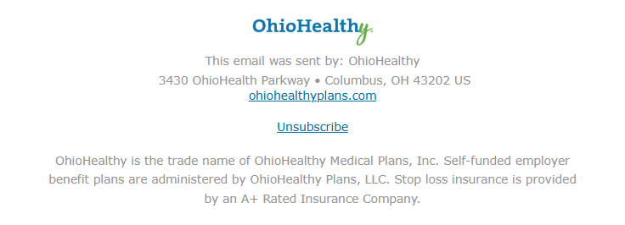
Sender address/name and email footer

Slide 3
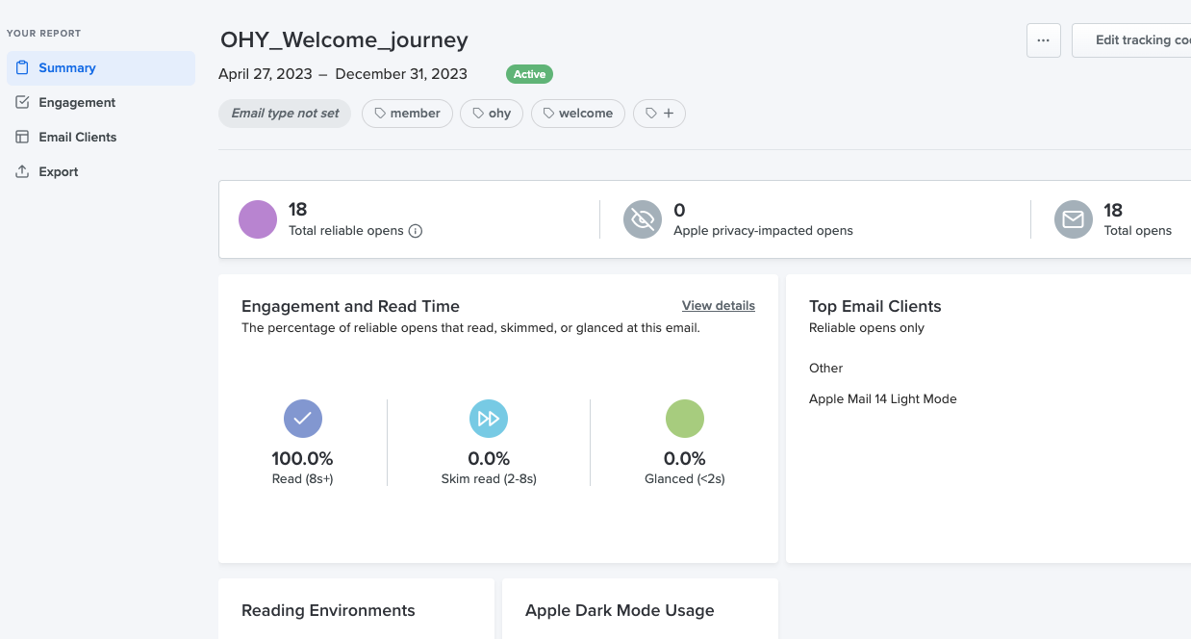
Litmus access
Data will update once activated
Access engagement dashboard https://litmus.com/pub/a/dQ16ON4jxE8dFiyl

Slide 4
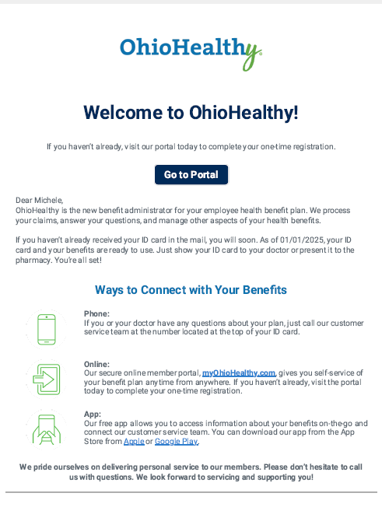
Email 1
Welcome
CTA = Portal

Slide 5
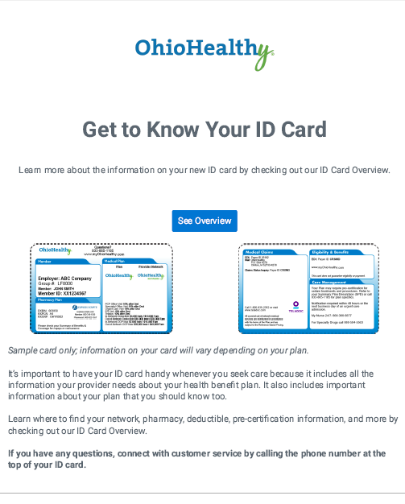
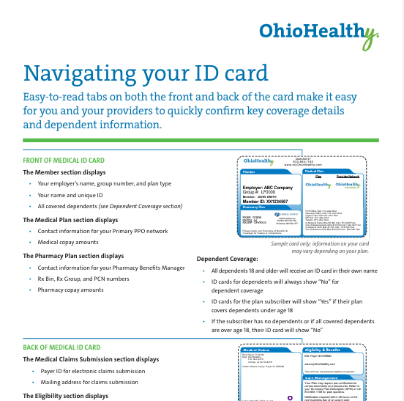
Email 2
ID card Tour
CTA = Navigating your ID card flyer based on Funding Type logic
Example shown LH-1715-OHy-0825

Slide 6
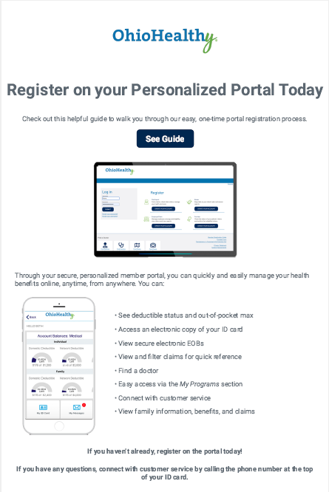

Email 3
Portal Registration
CTA = Member’s Guide to Registering
LH-714-OHy-0424

Slide 7
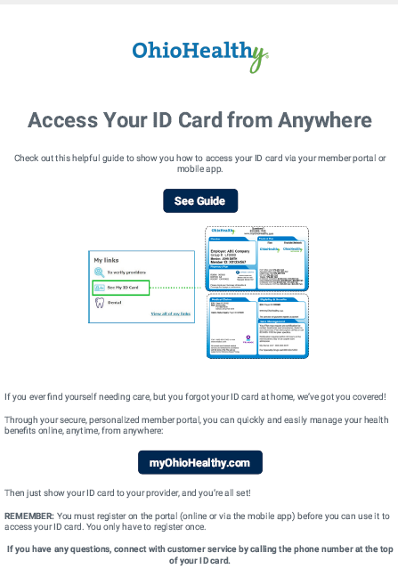
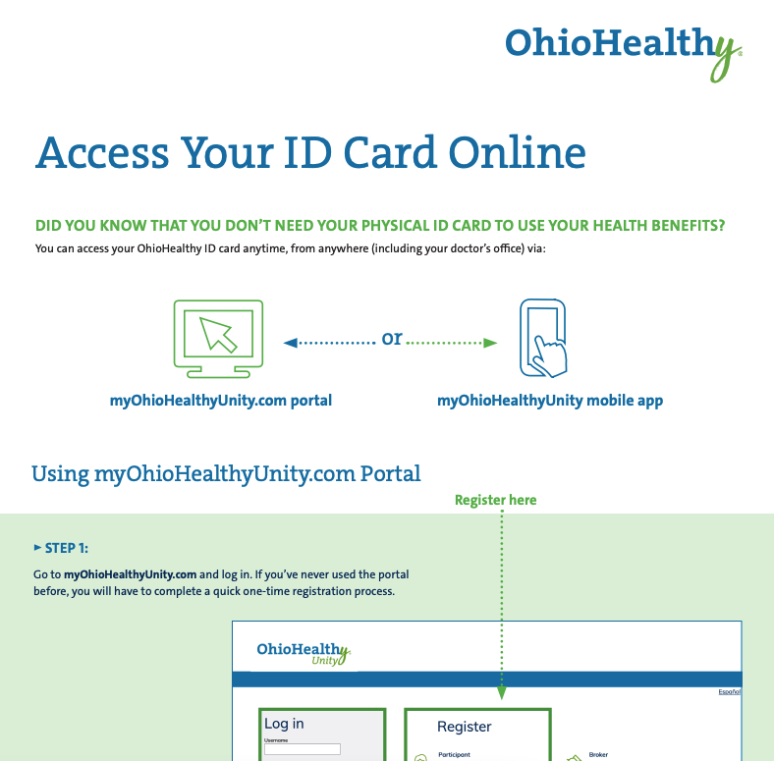
Email 4
Digital ID cards
CTA = Access Your ID card Online
  2nd CTA = Portal
LH-2455-OHy-0724

Slide 8
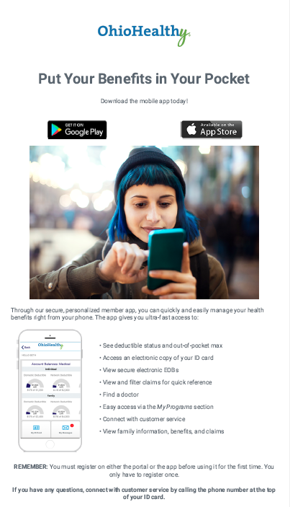
Email 5
Mobile app
CTA = Download your mobile app
  Google or Apple

Slide 9
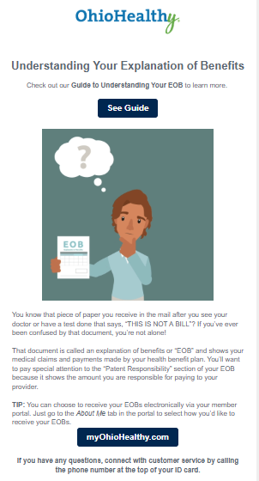

Email 6
Navigate your EOB
CTA = Understanding your Explanation of Benefits
  2nd CTA = Portal
LH-178-OHy-0724

