Slide 1
Welcome Journey
WEMP 2025
Luminare Health

Slide 2
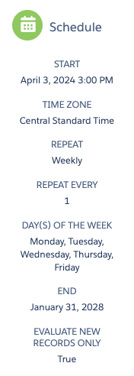
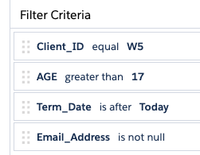
WEMP Welcome Journey
Evaluates file each weekday for:
    Effective date is before today
        If effective date is in the future, hold until 1 day after effective date
    Age is greater than 17
    Termination date is after Today

Slide 3
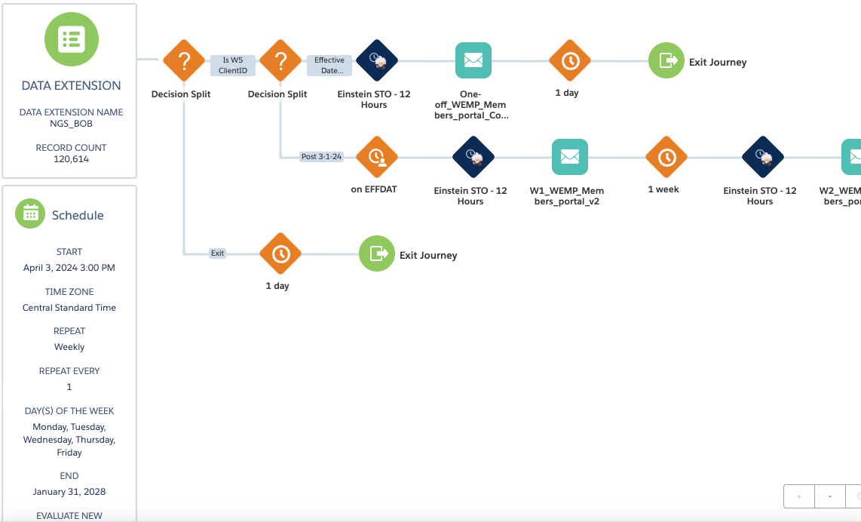
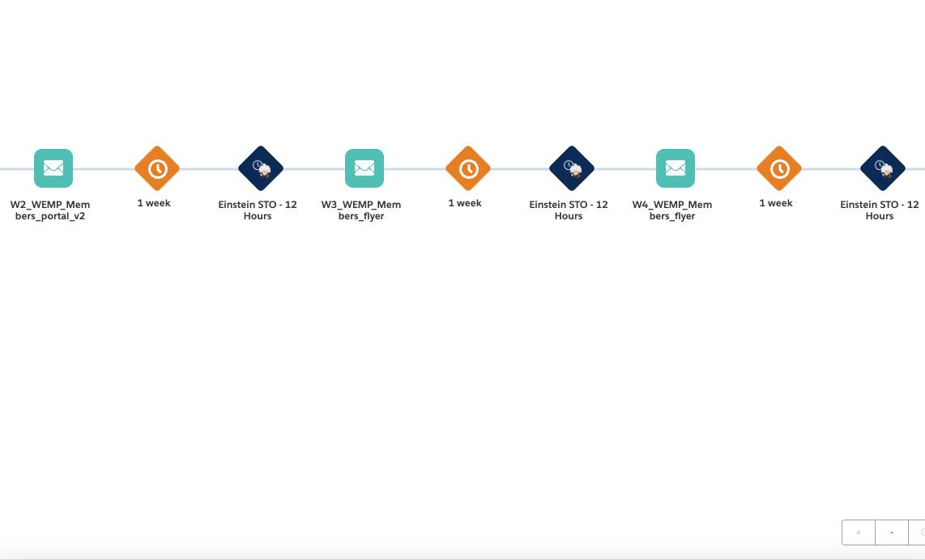
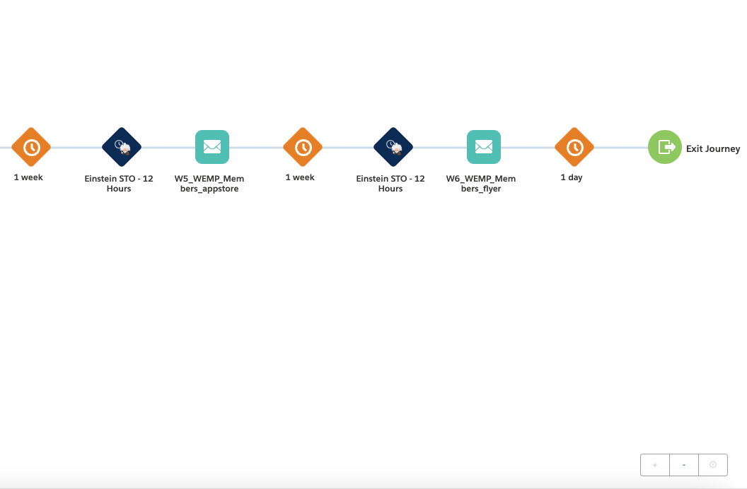
WEMP Welcome Journey

Slide 4
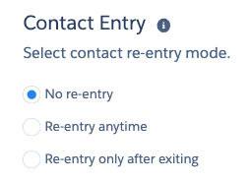
Run and entry criteria
Runs aprox 3 years
evaluates all records on first run, then only new
No re-entry allowed

Slide 5

Sender address/name
Monitored by Luminare Health for deliverability related issues

Slide 6
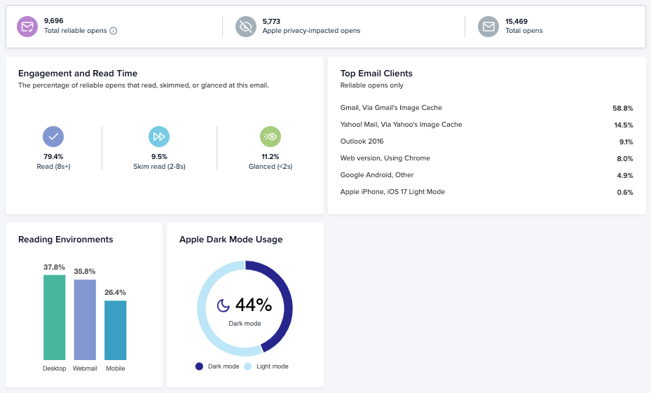
Litmus access
Data will update once activated
Access engagement dashboard
https://litmus.com/pub/a/xHmEQmVuwire6Fvc

Slide 7
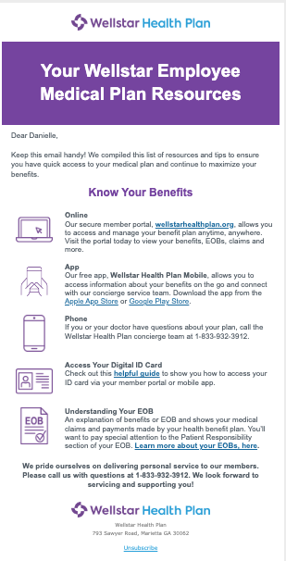
Email 1 Contingency
Consolidated for Jan-Mar onboarding
CTA = Portal
App
ID card guide
EOB info
Notes:
One email journey for members who have already been active and did not receive welcome journey. This is sent to all who have effective date prior to 3/1/24

Slide 8
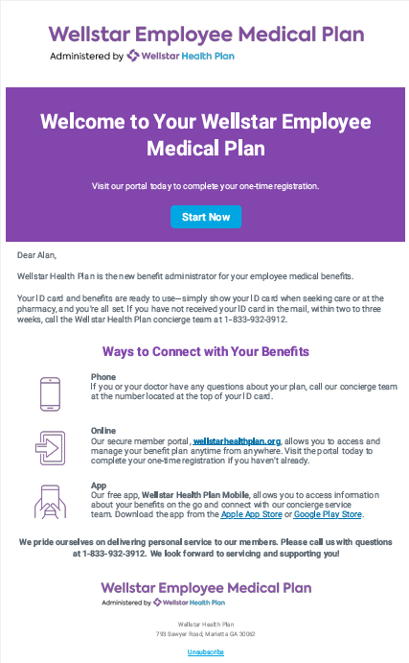
Email 1
Welcome
CTA = Portal
Apps

Slide 9
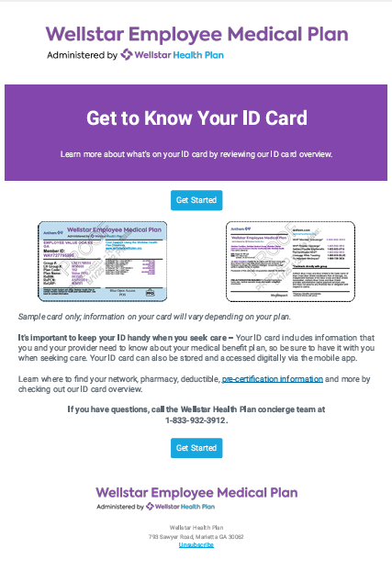
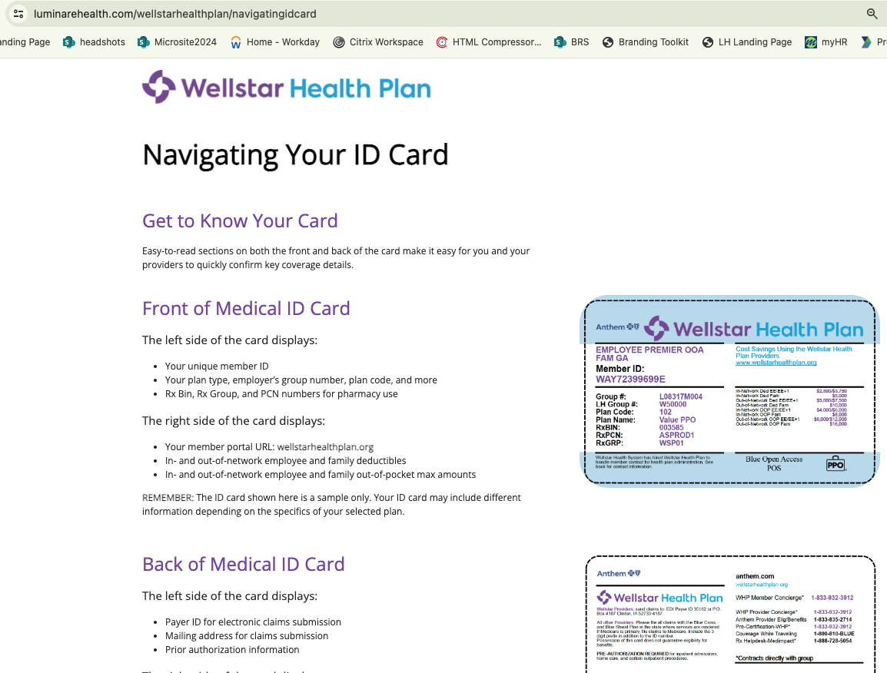

Email 2
ID card Tour
CTA = Navigating your id card landing page
Pre-cert flyer

Slide 10
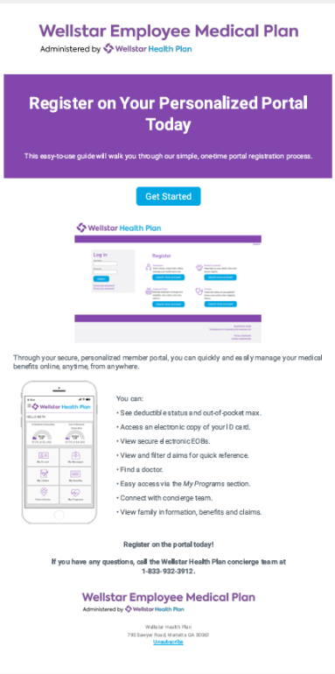
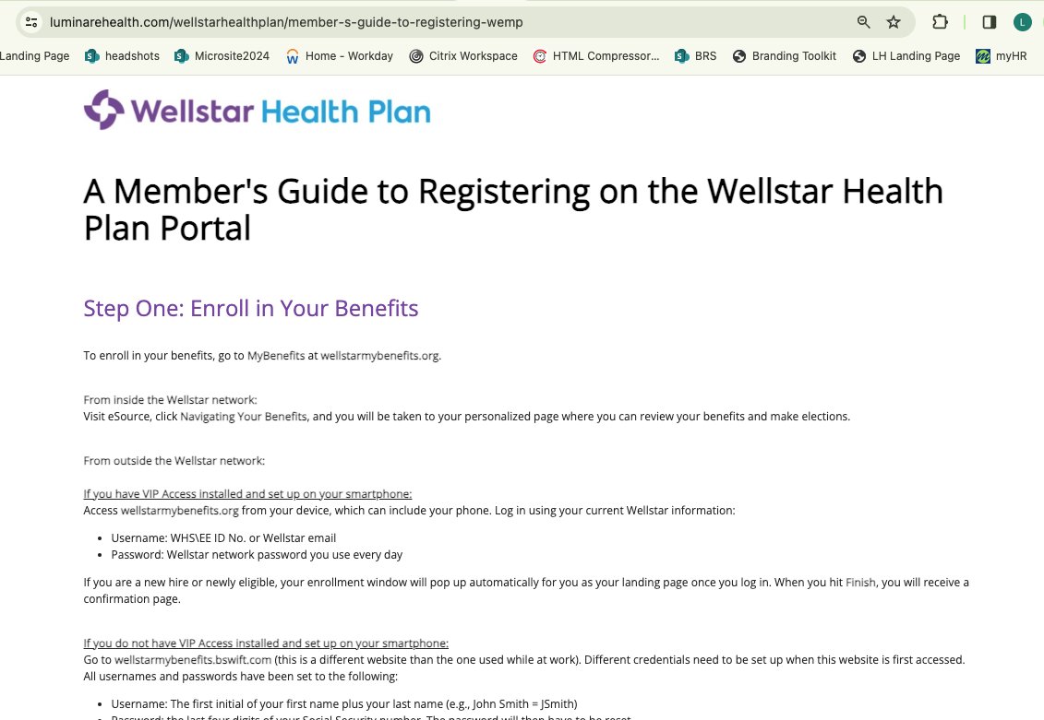
Email 3
Portal Registration
CTA = Member’s Guide to Registering Online
Links to landing page

Slide 11
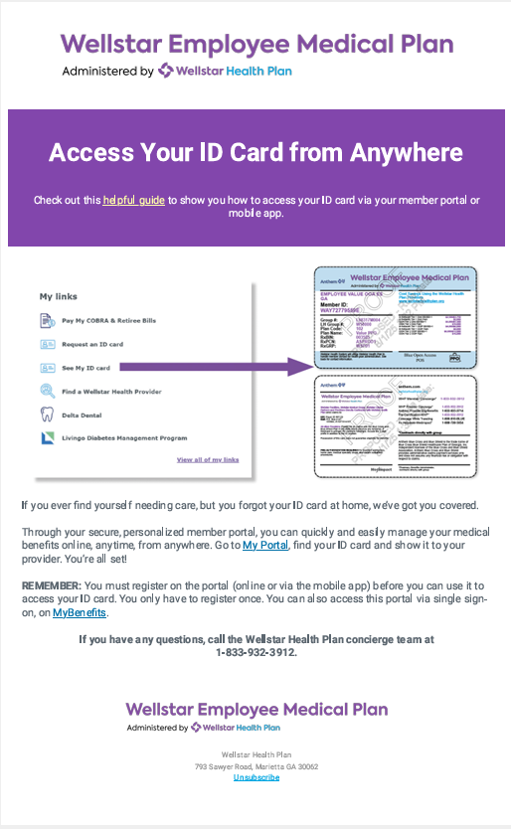
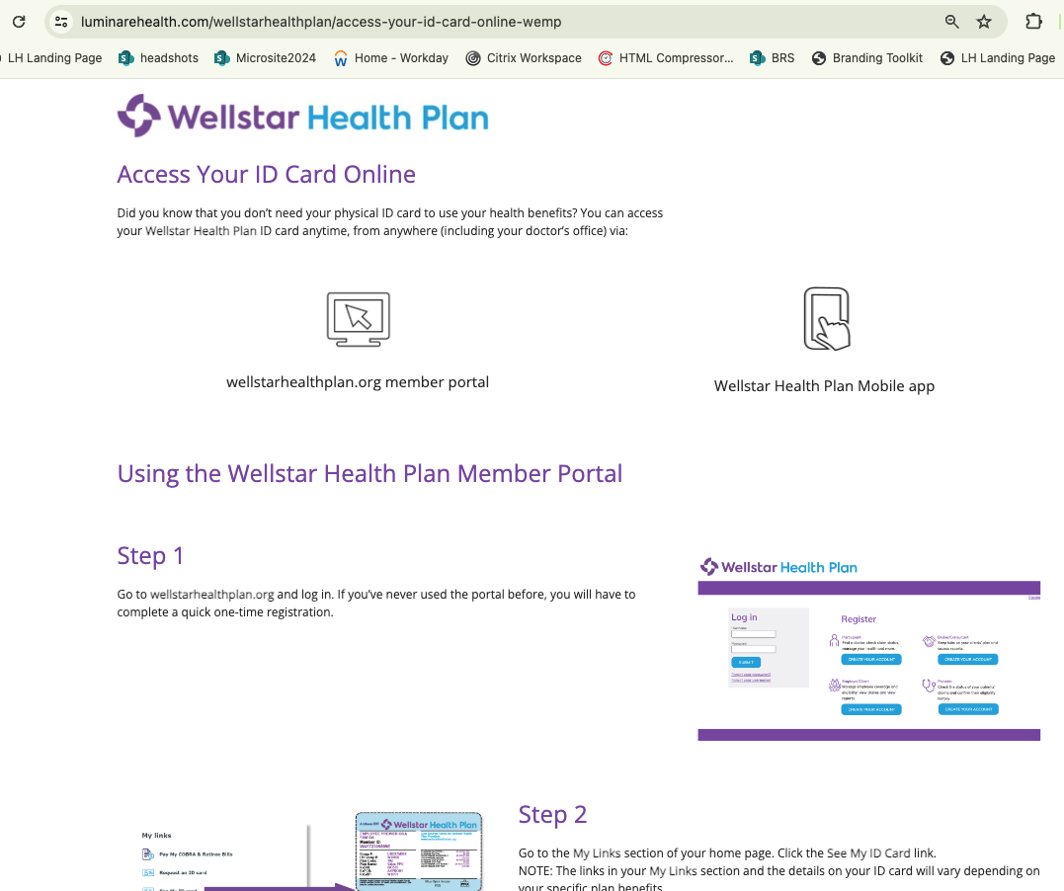
Email 4
Digital ID cards
CTA = Access Your ID card Online
Links to flyer LH-2455
MyBenefits

Slide 12

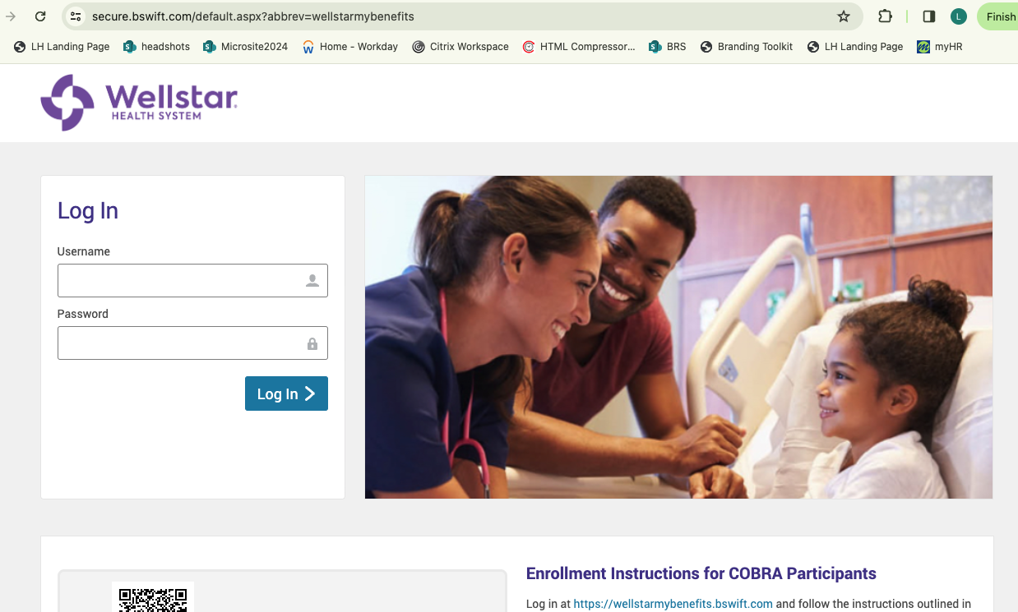
Email 5
Mobile app
CTA = Download your mobile app
  Google or Apple
  My Benefits

Slide 13
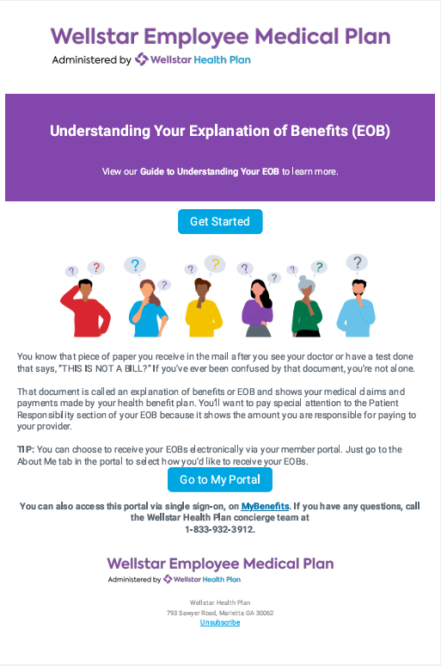
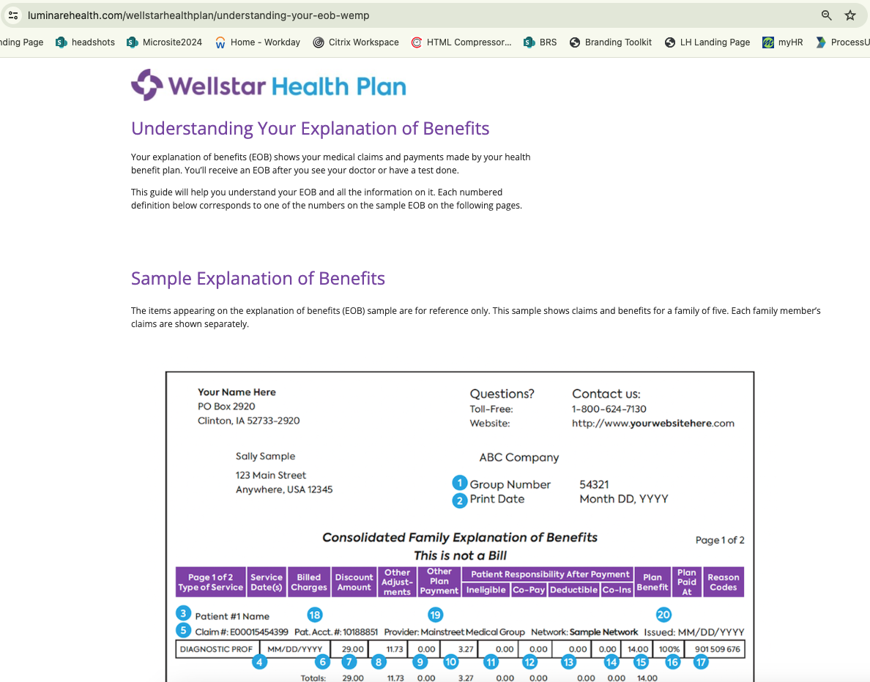
Email 6
Navigate your EOB
CTA = Understanding your Explanation of Benefits landing page
  2nd CTA = Portal

