Slide 1
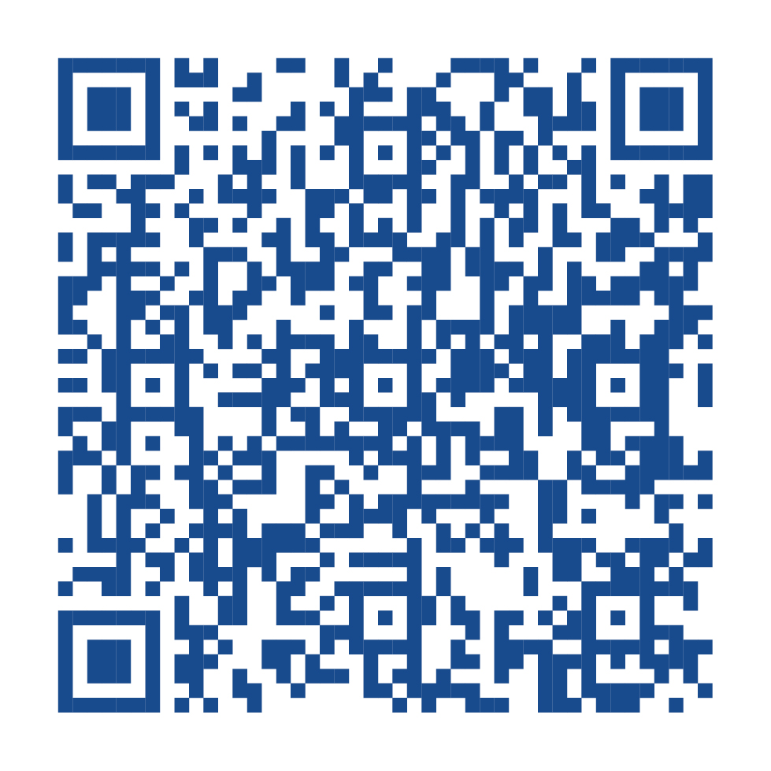
Memorial Health Plan
Care from Your Community, for Your Community
Scan the QR Code Below
to Learn More
Offering new direct-to-employer, self-funded health benefit plan options
Bringing personalized healthcare solutions to local employers and employees
Providing excellence, integrity, and service to the Greater Shiawassee County area
Going live for April 1, 2024

