Slide 1
Welcome Journey
EVHC 2026
Luminare Health

Slide 2
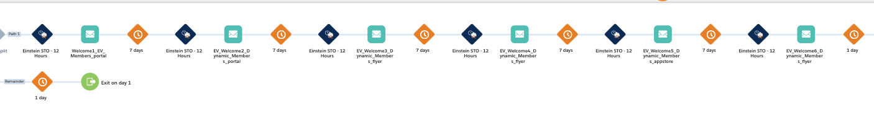
EVHC Welcome Journey
Evaluates file each weekday for:
    Effective date is before today
        If effective date is in the future, hold until 1 day after effective date
    Age is greater than 17
    Termination date is after Today
    Either enter based on hold code of EH / ‘Y or if team prefers, as directed client by client basis
    Runs on weekdays, sends 1 week apart
    Use AI for send time optimization over 12 hour window

Slide 3
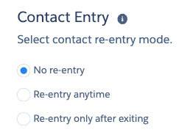
Run and entry criteria
Runs aprox 3 years
evaluates all records on first run, then only new
No re-entry allowed

Slide 4

Sender address/name
Monitored by Luminare Health for deliverability related issues

Slide 5
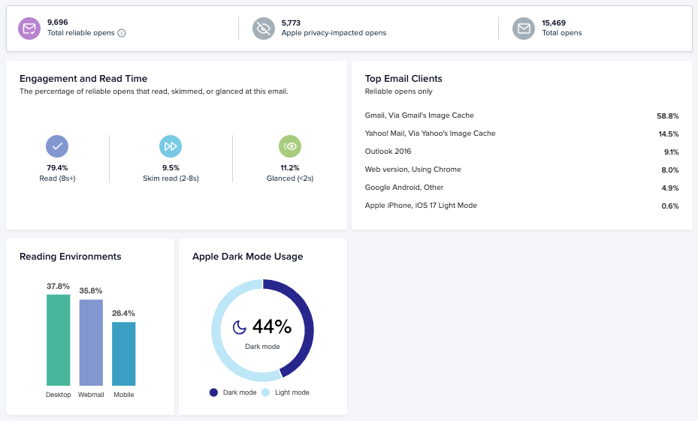
Litmus access
Data will update once activated
Access engagement dashboard
Link to be shared

Slide 6
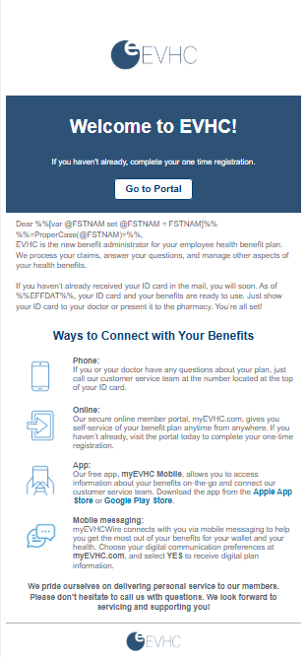
Email 1
Welcome
CTA = Portal
  App
  Text opt in

Slide 7
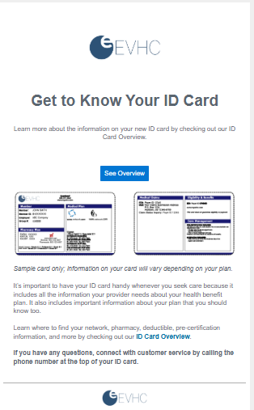
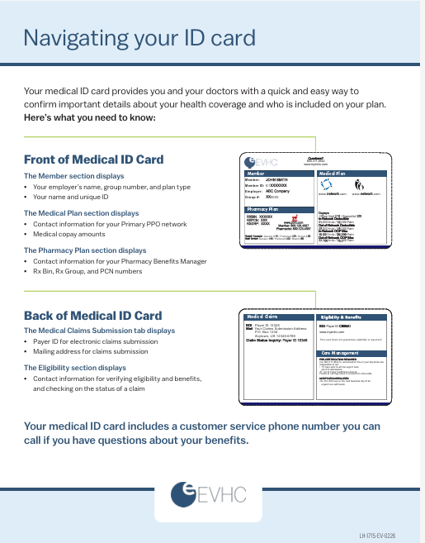
Email 2
ID card Tour
CTA = Navigating your id card flyer

Slide 8
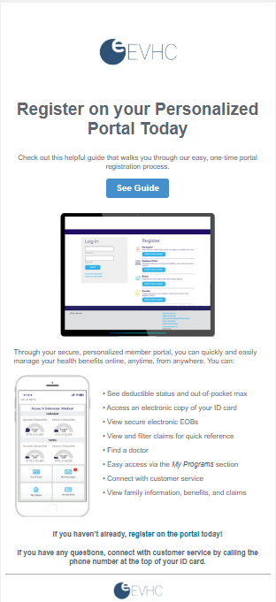
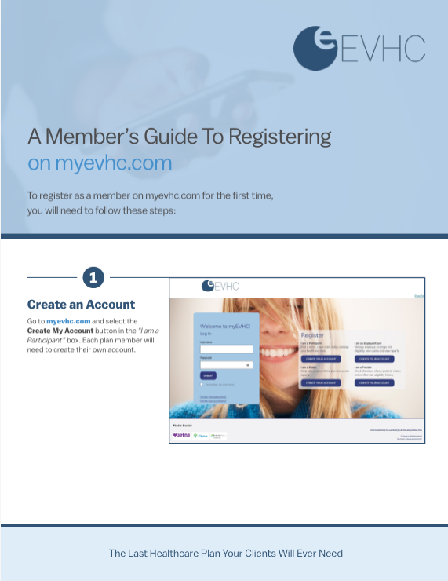
Email 3
Portal Registration
CTA = Member’s Guide to Registering Online
Links to flyer

Slide 9
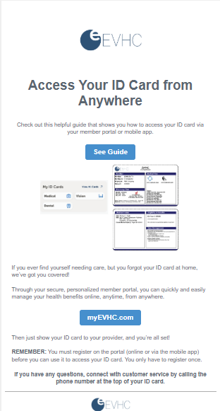
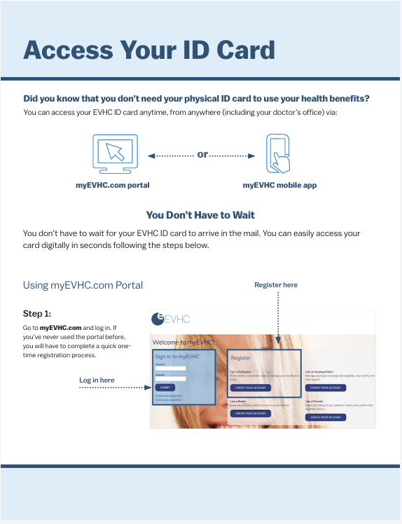
Email 4
Digital ID cards
CTA = Access Your ID card Online
Links to flyer LH-2455
Portal

Slide 10
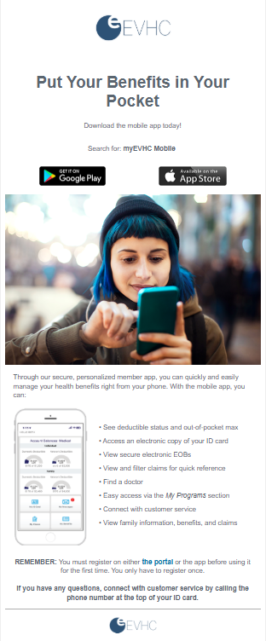
Email 5
Mobile app
CTA = Download your mobile app
  Google or Apple
  Portal

Slide 11
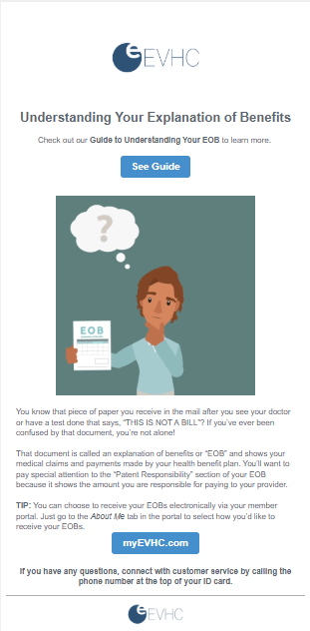

Email 6
Navigate your EOB
CTA = Understanding your Explanation of Benefits flyer
  2nd CTA = Portal

